Slide 1
SAGE’s Open Access Workflow for Unit, Norway
Lucy Robinson
Executive Publisher, Business Development
Notes:
Intro…

Slide 2
SAGE Open Access Portal:
Bringing together all our Open Access (OA) processes into a single system provided by one customer facing portal.
Payment Processing
Automated Author Compliance/license selection
Live tracking
Detailed reporting
Phase 1: Now live for all hybrid (SAGE Choice) open access.
Phase 2: Pure Gold migration progressing for completion in the summer
Phase 3: Customer reporting dashboards for institutions and consortia
A fully flexible solution to meet the needs of SAGE’s journals, authors and library customers into the foreseeable future.
Notes:
Soft launch SAGE Open Access Portal – some of the wording and screens may be subject to change

Slide 3
SAGE/Unit Agreement
Unlimited open access publishing rights in more than 900 hybrid journals
A 20% discount in Gold Open Access journals
Read access rights
Publishing with a CC BY licence
Notes:
Unlimited open access publishing rights in more than 900 hybrid journals including titles published on behalf of, or in association with, over 400 societies
A 20% discount in 150+ pure Gold Open Access journals published by SAGE
Read access rights to more than 900 peer-reviewed journals (950,000+ articles), content ownership of the subscribed content published by SAGE, as well as new content added to the package annually
Publishing with a CC BY licence unless otherwise requested by the author

Slide 4
What makes an article eligible for the Unit Agreement?
Corresponding author affiliated with a member institution
Contract dates – 1st January 2020 – 31st December 2022
Journal is included in the SAGE Premier 2019 package
Article type
Author accepts the offer of open access accepted within 2-week timeframe (hybrid)
Notes:
Corresponding author is affiliated with a member institution - we use Ringgold ID and will look at this in the next slides.
Article received in SAGE’s Production system, SMART, within the contract dates –
1st January 2020 – 31st December 2022
Journal is included in the SAGE Premier 2020 package which includes over 900 hybrid titles
Article type - Open Access Material includes, but is not limited to, original research papers, review papers, brief communications, short reports and case reports. Article types that are excluded are aticles published as part of commercially sponsored supplements, errata, book reviews, editorials, published abstracts, call for papers, news items or similar.
Author accepts the offer of open access accepted within 2-week timeframe (hybrid)

Slide 5
How is eligibility verified?
Submission and Peer Review (ScholarOne): Author inputs institution (Ringgold ID)
Production (SMART): Ringgold and OpenFunder ID metadata checks by SAGE Production
Sale Deal Identifier module runs on all journal articles
Eligible articles routed to SAGE Open Access Portal
Then…
All articles automatically, proactively checked against Bibsam Agreement parameters:
Journal package list
Contract dates
Corresponding author Ringgold IDs
Article type

Slide 6
Submission and Peer Review – Ringgold ID
Notes:
Ringgold ID database integrated with ScholarOne MS
Author should select from dropdown menu
Submitting author is default the corresponding author. The author must email the journals editorial office if they are not the submitting author to ensure they are selected as the corresponding author.

Slide 7
How is eligibility verified?
Submission and Peer Review (ScholarOne): Author inputs institution (Ringgold ID)
Production (SMART): Ringgold and OpenFunder ID metadata checks by SAGE Production
Sales Deal Identifier module runs on all journal articles
Eligible articles routed to SAGE Open Access Portal
Then…
All articles automatically, proactively checked against the Unit Agreement parameters:
Journal package list
Contract dates
Corresponding author Ringgold ID
Article type

Slide 8
Open Access Offer Email
Notes:
Standard workflow
Soft launch – some of the wording and screens may be subject to change
Author and co-authors
Deal text & link to information on consortium
Benefits of OA
Button to access portal

Slide 9
Choose Open Access
Notes:
4 step process
Step1 – choose OA
Deal wording
Discount applied
Two options – Yes / No, do not make my article open access

Slide 10
Declining Open Access Offer
Notes:
Reason is required
Author must let us know who they are
Report on to

Slide 11
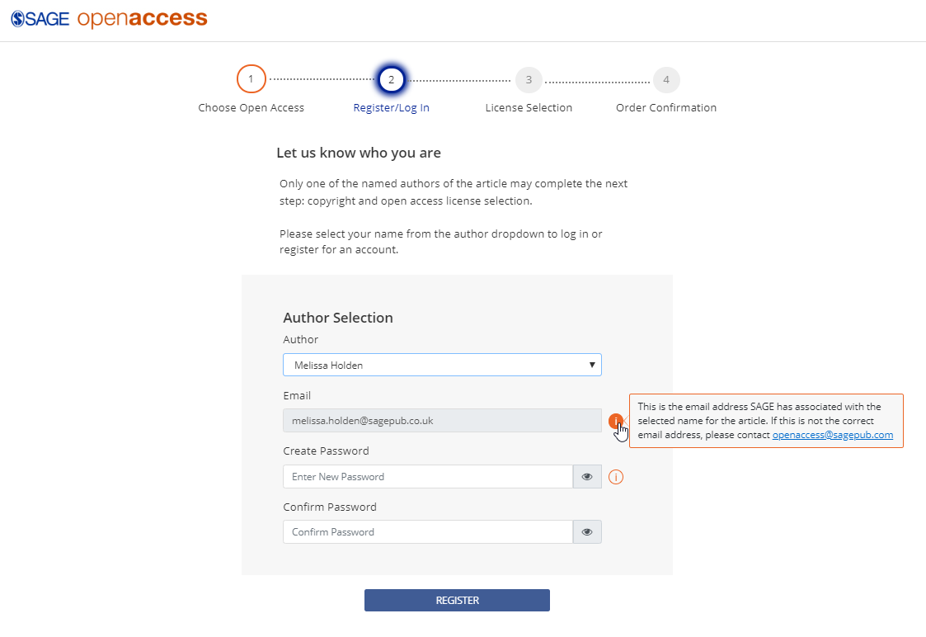
SOAP: Register/Log in
Any author can take action
Select name from the dropdown
Register account with email address in article metadata
SAGE must know who is signing the license

Slide 12
Open Access License Selection

Slide 13
Open Access License Selection

Slide 14
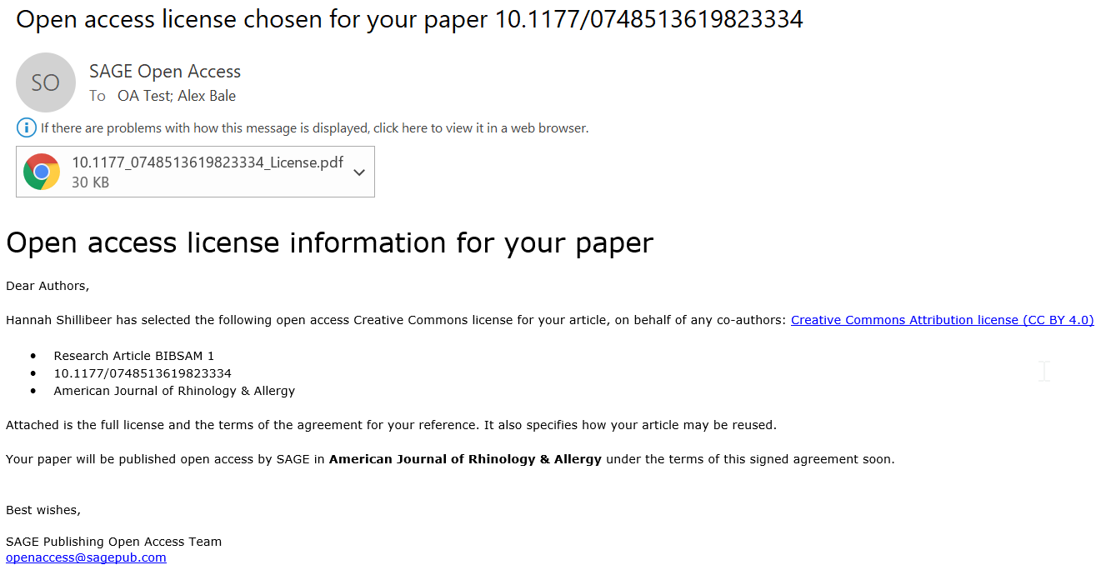
Order confirmation
Notes:
Add screenshot of OA license selected email – goes to all authors

Slide 15
Pure Gold Open Access Journals
20% discount for Unit corresponding authors
Author enters the discount code UNIT2020 into our current APC collection system (RightsLink)
Gold titles launching on the SAGE Open Access Portal Summer 2020
Discount will then be fully automated. No action will be required by authors or institution.
Option to set up OA prepay account or aggregated billing to fund Gold OA APCs
Become Centralised Bill Payer (CBP) in our system with option to see either
a) all articles to pre-approve eligibility and decide on whether to funding any APC centrally
b) have a CBP profile with us to enable an author to select you as their bill payer for you to approve or decline case by case

Slide 16
What can library staff do to help authors?
Promote the agreement with SAGE to faculty
Ensure correct links to SAGE and Unit websites are provided to faculty https://uk.sagepub.com/en-gb/eur/open-access-agreements-at-sage/norway
Encourage faculty to make the article submission
Encourage faculty to pick their main institutional affiliation at submission
Encourage faculty to use their institutional email domain when submitting
Notes:
Knowledge – if author expects to hear from SAGE they are more likely to take up the offer of open access and more quickly. (seen this with VSNU)

Slide 17
Reporting
Author dashboard
Pre-approve workflow – self serve article report
Agreed reporting to consortium
Consortium and institution self service reporting via SAGE Open Access portal – coming soon
Notes:
Author dashboard – in progress and transacted articles
Confirm if reporting is twice a year??

Slide 18
How to get help
Help area coming soon
Agreement pages coming soon
User manuals coming soon
Dedicated open access customer service team
Reply to or send an email to SAGE Open Access customer service openaccess@sagepub.com

Slide 19
Thank you for listening
Lucy Robinson: Lucy.Robinson@Sagepub.co.uk

