Slide 1
Publishing options:
SIKT institution affiliated corresponding authors: Author receives 15% discount & invoices the institution/funder of their choice

Slide 2
Key information
How do we determine eligibility of the article for the SIKT agreement?
The acceptance date of the article should be on or after the start date of the agreement
The corresponding author must be affiliated with the participating institutions
The article must be from a participating journal

Slide 3
Key information
2. Role of the institutional librarian in the Elsevier OA Platform (EOAP)
By the time the article is in your EOAP, we have published the first version of the article in ScienceDirect (within 48 hours of acceptance)
You therefore do not approve the publication of the article, you validate whether the corresponding author can make use of the discount under the agreement
As a librarian, you have full rights to decide whether the author is eligible for the agreement

Slide 4
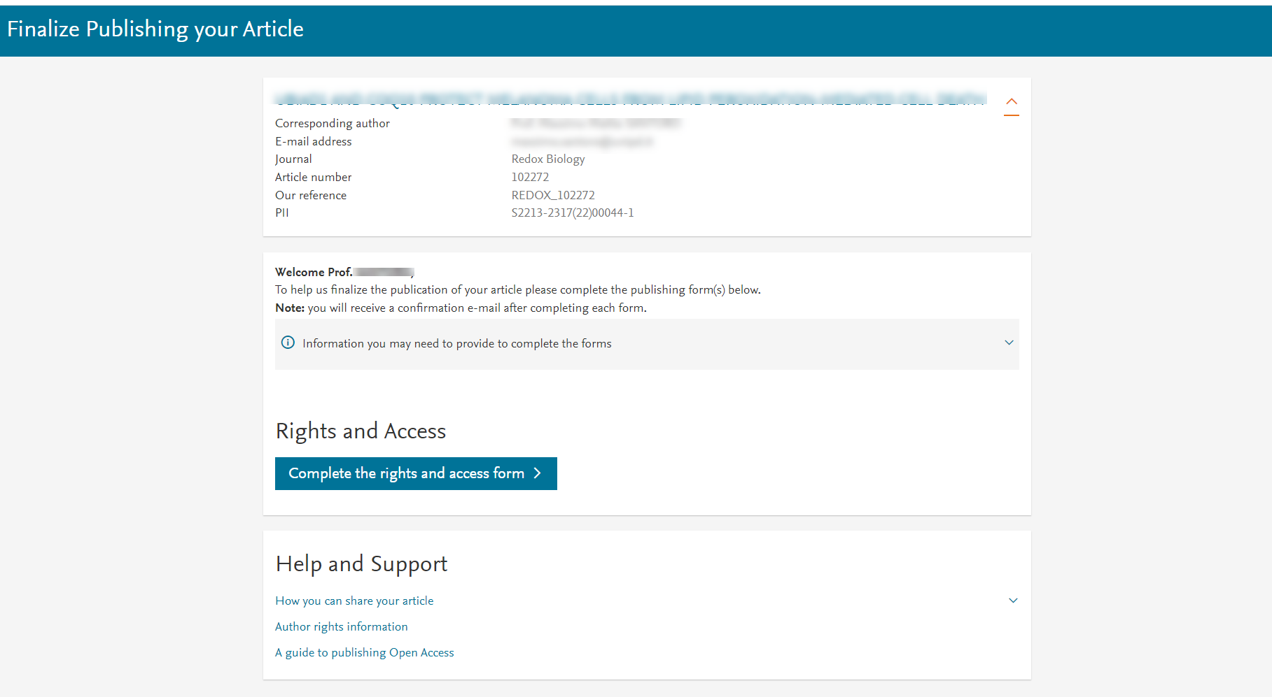
Corresponding author receives an email post acceptance with a unique link to complete the author journey and choose publishing options
Authors clicks on the ‘Complete the Rights and Access information form’

Slide 5
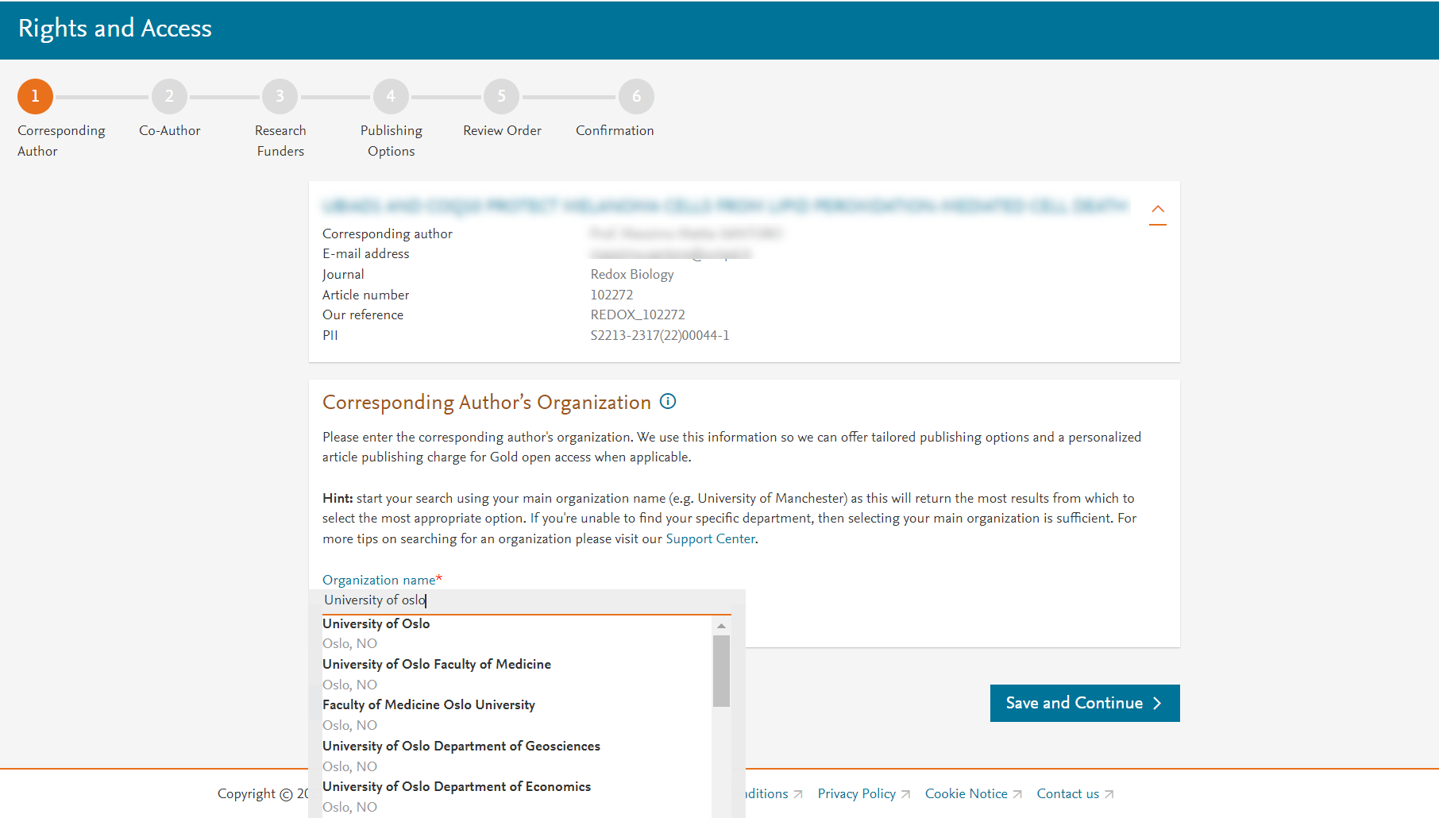
Corresponding author selects his/her affiliation details which we use to identify the authors and match them to the SIKT agreement

Slide 6
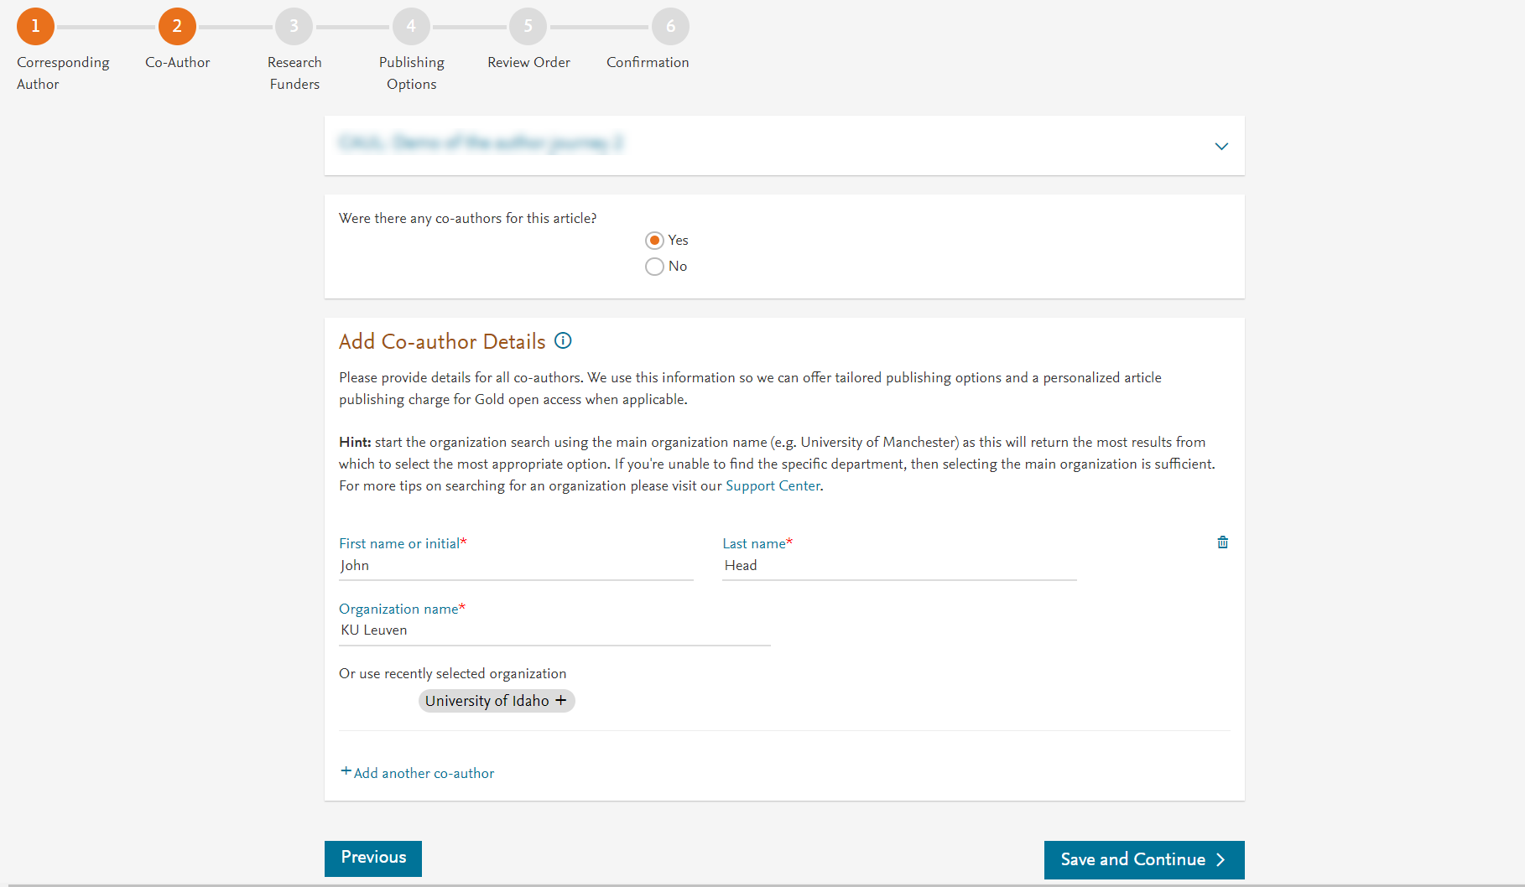
Corresponding author also adds the co-author affiliation details

Slide 7
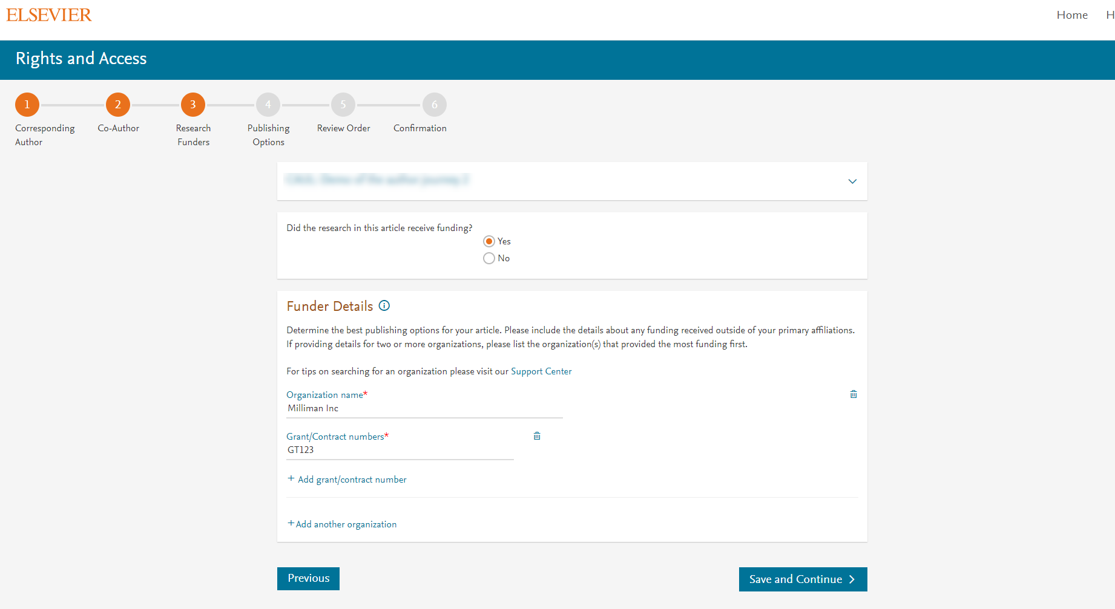
Author can add the Funder details. Funder can be the affiliated institute or a different one. In this case Milliman, United States is the Funder

Slide 8
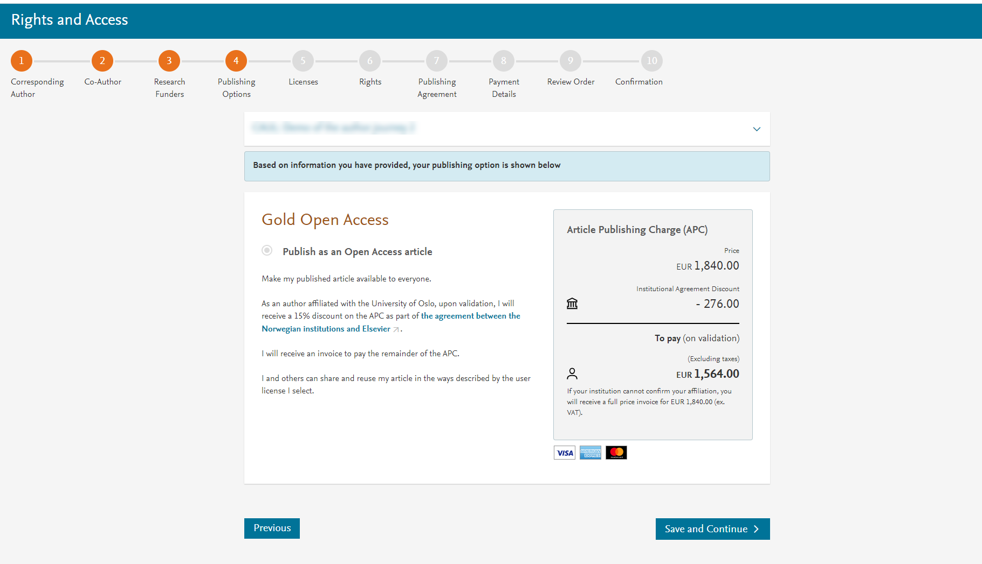
Based on the corresponding author affiliation details, the author sees the Gold only publishing Option. We make it clear that author receives a 15% discount on the APC for Gold OA upon validation
If the librarian at the consortium rejects the author request in the Elsevier Platform, we make it clear that the author will receive a full price invoice

Slide 9
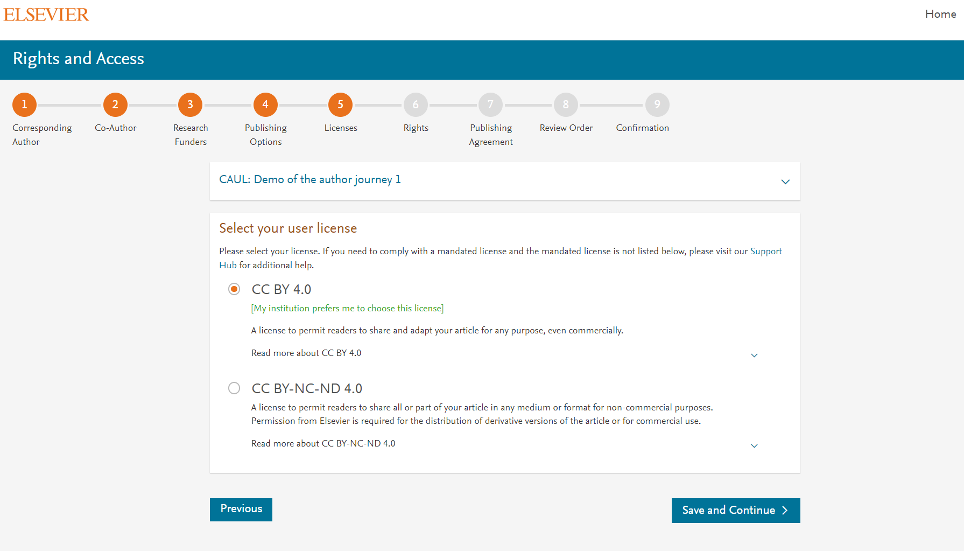
Elsevier offers two CC licenses
Author selects CC BY NC ND in this case

Slide 10
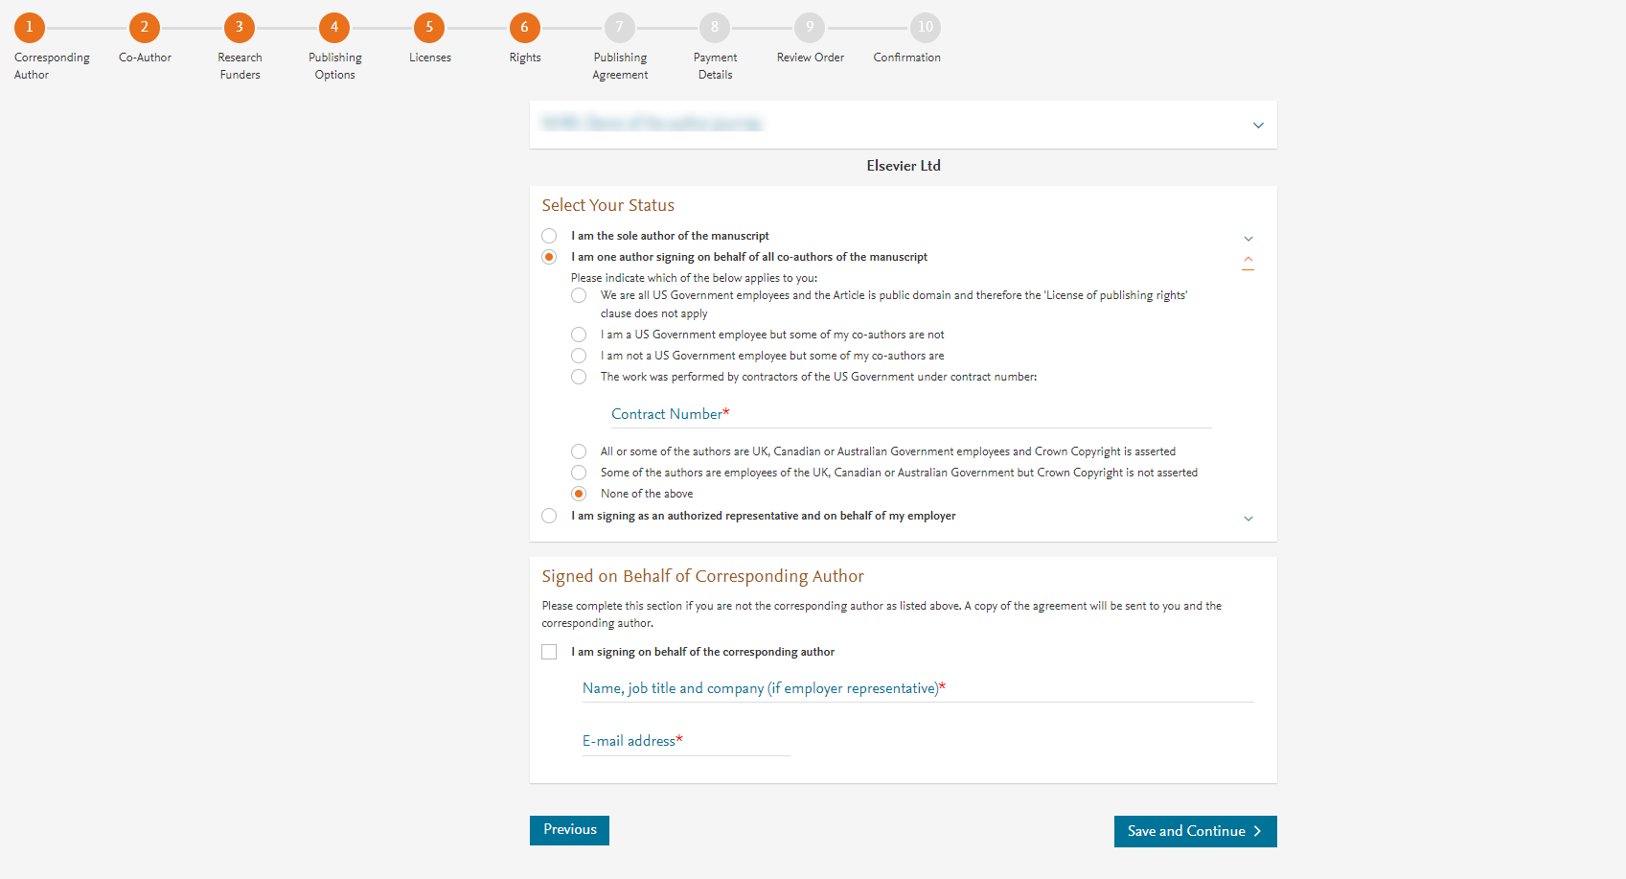
Author selects the rights

Slide 11
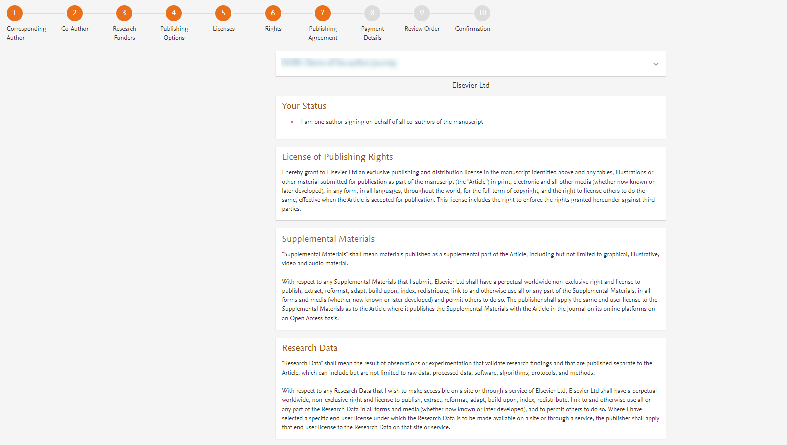
System presents author with the Journal License Publishing Agreement

Slide 12
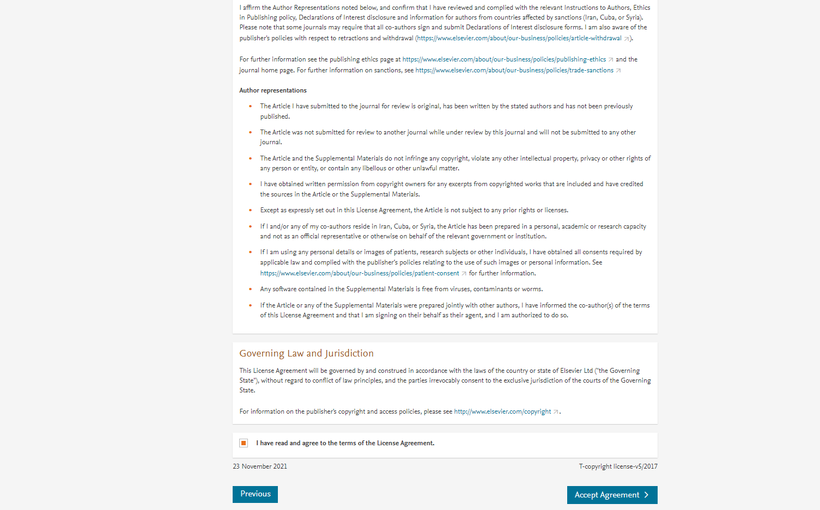
Author agrees to the Journal License Publishing Agreement

Slide 13
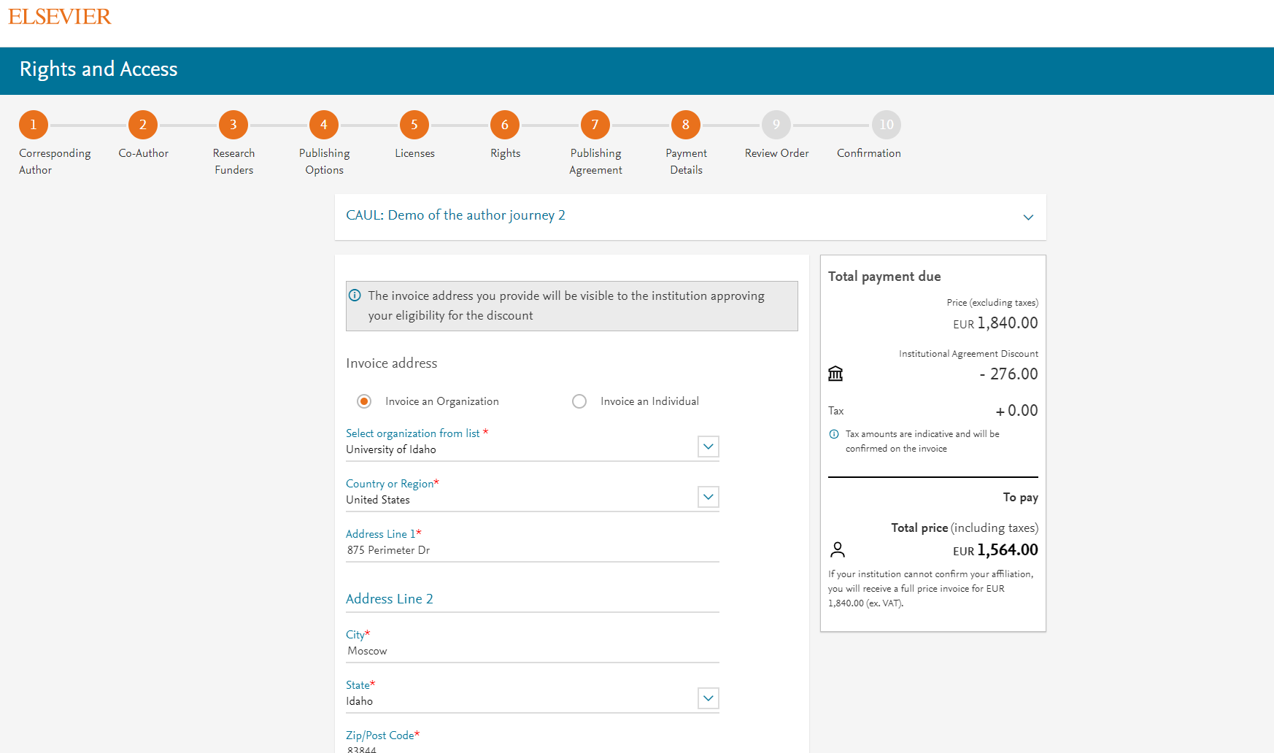
Authors chooses to send the invoice to the organization billing details

Slide 14
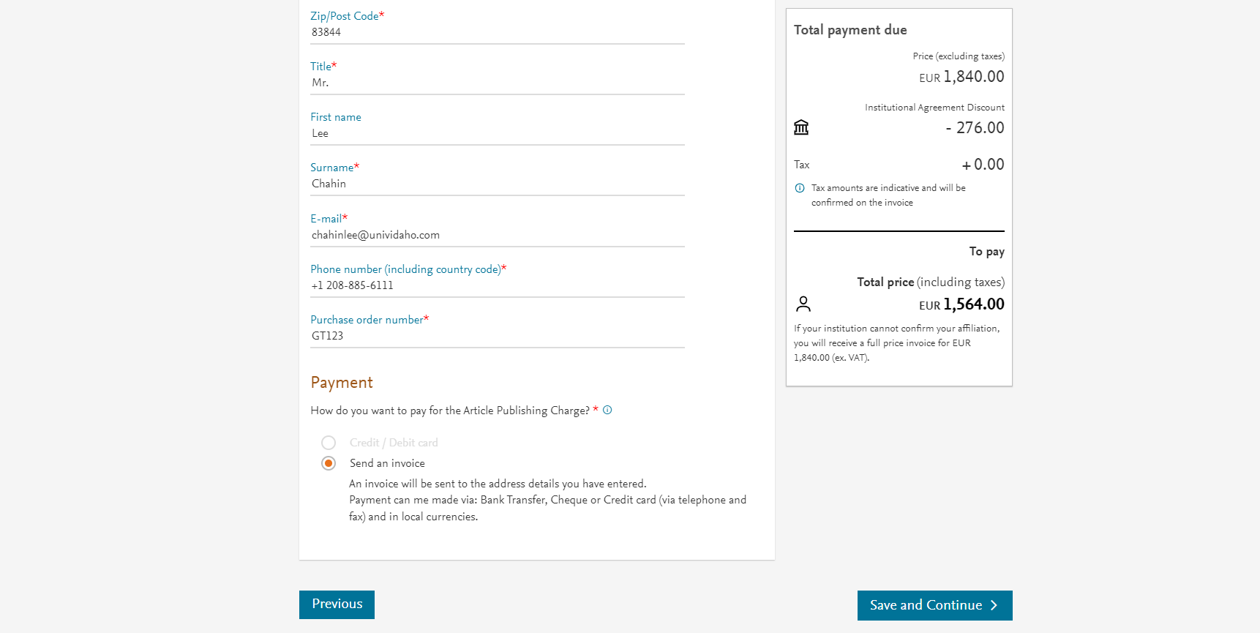
Author can add the VAT number, Tax exemption details. PO number is mandatory

Slide 15
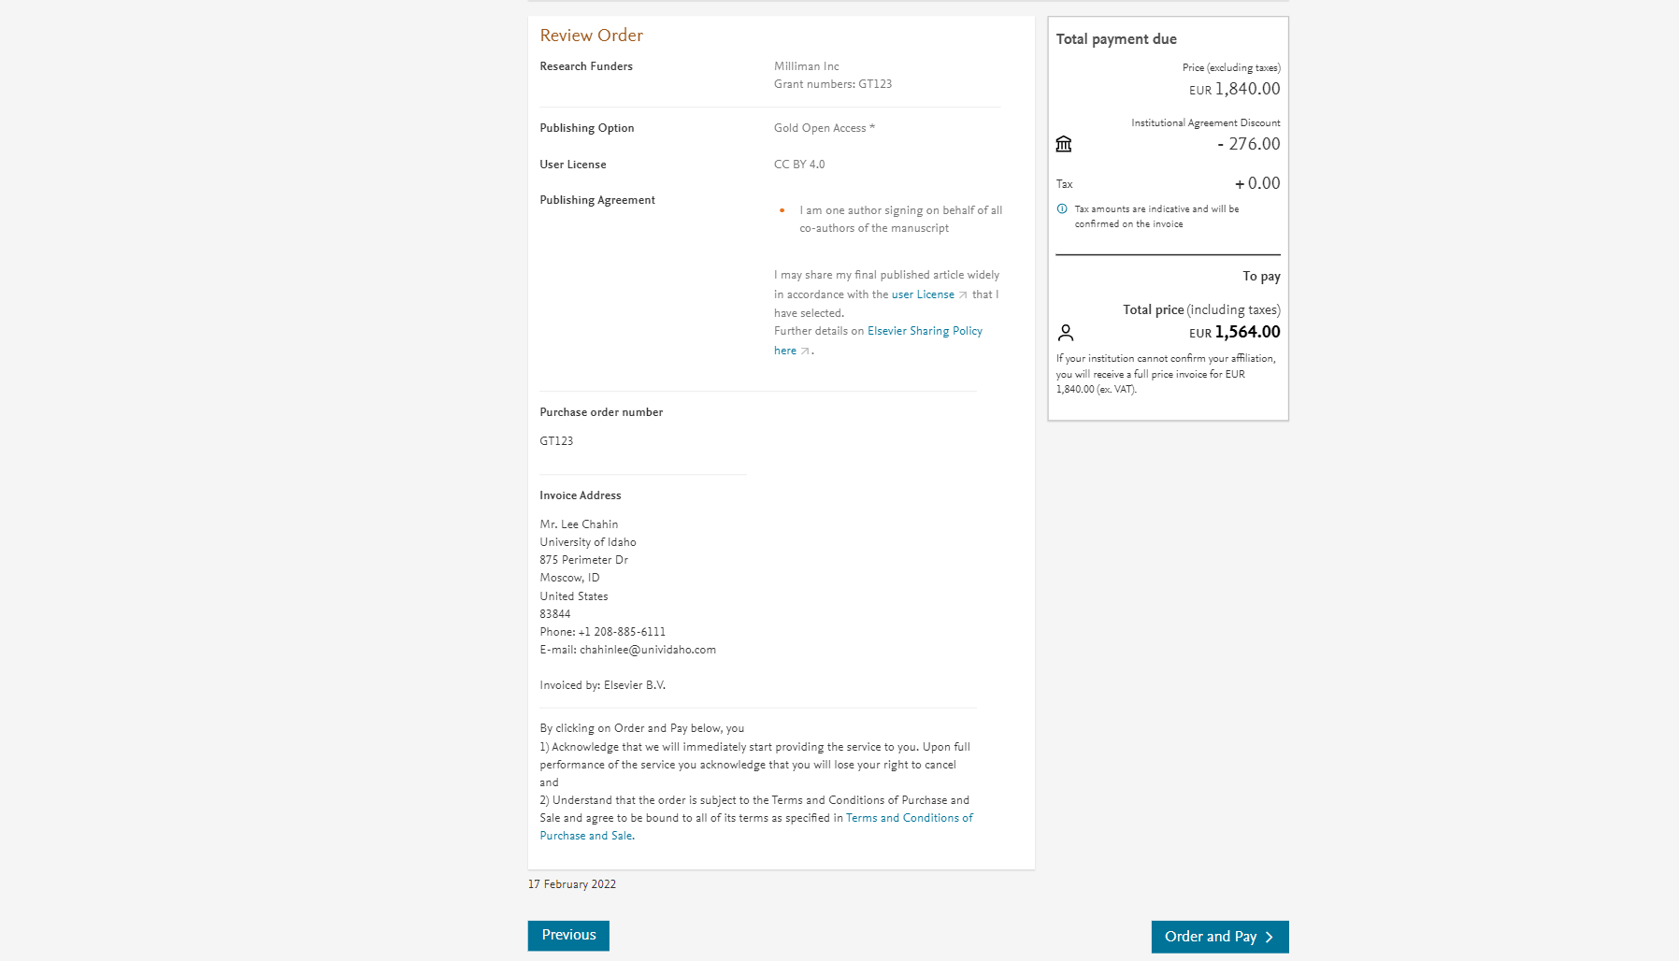
Once the author clicks on order and pay:
Corresponding author and coauthors receive a copy of summary via email
Librarian at the institute will receive a notification for validation within 48 hours who then has 3 weeks to validate the request
If the librarian approves the request, the author will receive the discounted invoice
If the librarian rejects the request, the author will receive the full price invoice

Slide 16
Support for authors and librarians
Author queries – support@elsevier.com
Librarian queries, EOAP account set up or changes – agreementactivation@elsevier.com
Author journey videos: https://service.elsevier.com/app/answers/detail/a_id/29789/supporthub/publishing/track/APN2ZgoIDv8a~RNiGvwa~yKgpv0qOS75Mv9e~zj~PP_X/

