Slide 1
Introducing SciPost
Jan Willem Wijnen, Strategy Officer
Scipost.org

Slide 2

SciPost mission
Develop and manage true open science journal platform
Diamond open access, no costs to authors, no paywalls
Non profit
For and by scientists, all decisions made by active scientists
Open peer-review, posting of review reports and updated manuscript versions
Transparent organisational and financial structure, posted on website
Financially supported by over 60 organisations, mainly university libaries

Slide 3
Currently publishing
SciPost Physics (launched in 2016, now impact factor 5.051)
Four other physics journals, publishing different content types
Journals in other disciplines in the making (astronomy, chemistry, political sciences)
All diamond open access: no costs to authors, no paywalls

Slide 4
Partner institutes/organisations see https://scipost.org/sponsors/
Research councils;
  NWO (Netherlands), FWF (Austria), European Research Council, Max Planck Gesellschaft (Germany), …
  Typical contribution EUR 5-30k for development
University libraries:
  About 50, mainly in Netherlands, Germany, Belgium, UK, Sweden, France, Australia,…
  Typical contribution EUR 1,000, with request for renewal in autumn
Motivation of partners is clear benefit to their institute and enthusiastic support for new non-profit open access initiative

Slide 5
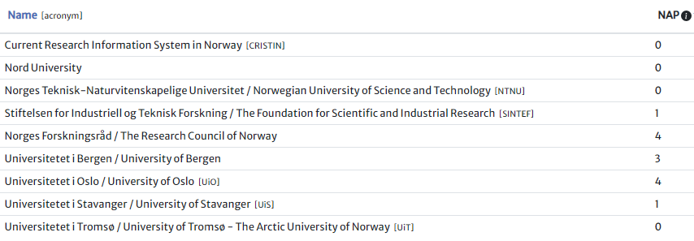
Norway
Number of Associated Publications(NAP) from Norwegian institutes (2016-2020):
See https://scipost.org/organizations/?country=NO

Slide 6
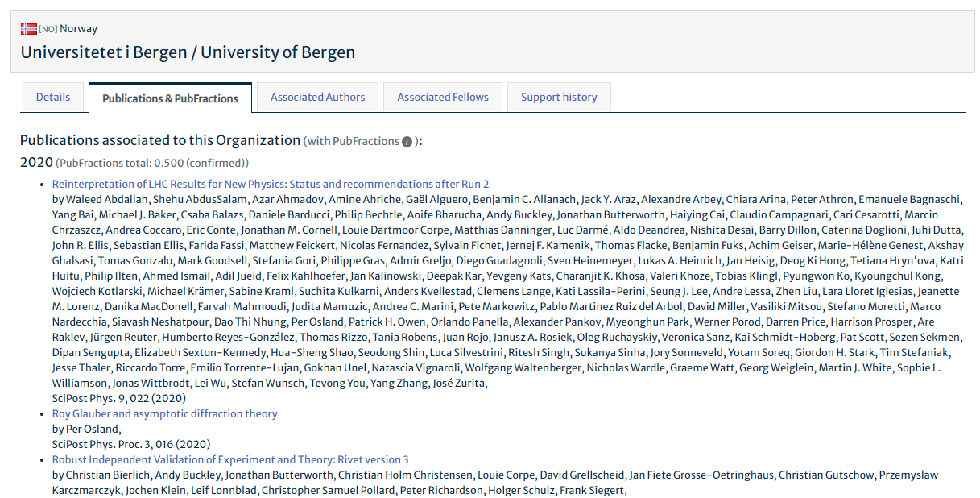
Details per institute
Number of associated papers from Norwegian institutes (2016-2020):
See https://scipost.org/organizations/453/

Slide 7
Partner institutes/organisations
Promote SciPost to constituents as good, open access venue for research results
Include SciPost in recommended journals
Currently no Norwegian partner organisation
Norway is strong supporter of open science
SciPost would be delighted establishing closer ties with Norwegian research community through a partnership
Thank you!

