Slide 1
Publishing options: Norwegian institute associated corresponding authors

Slide 2
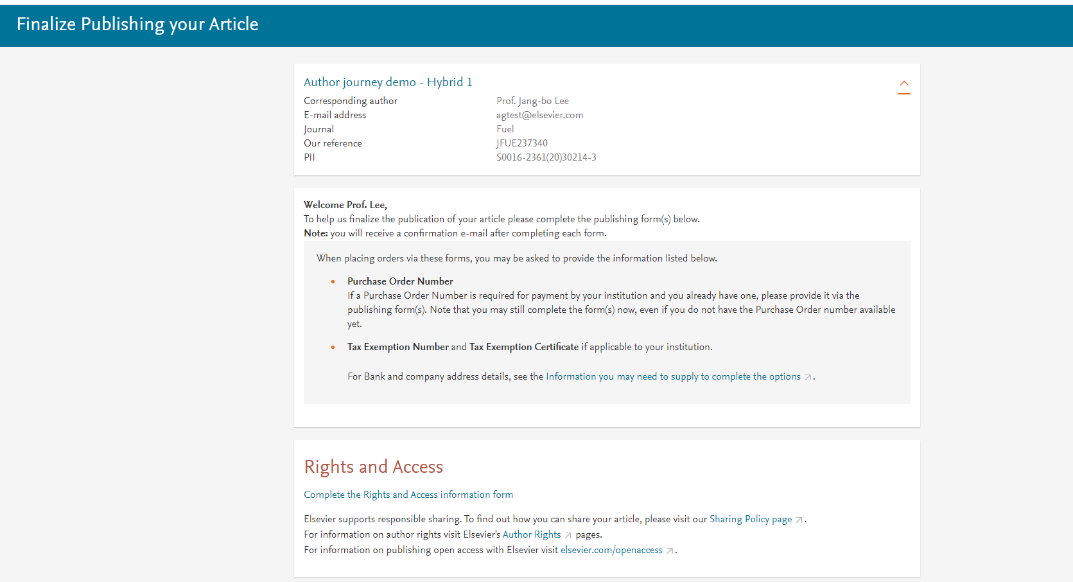
Corresponding author receives an email post acceptance with a link an unique link to complete the author journey and choose publishing options
Author should click the “Rights and Access information inform”

Slide 3
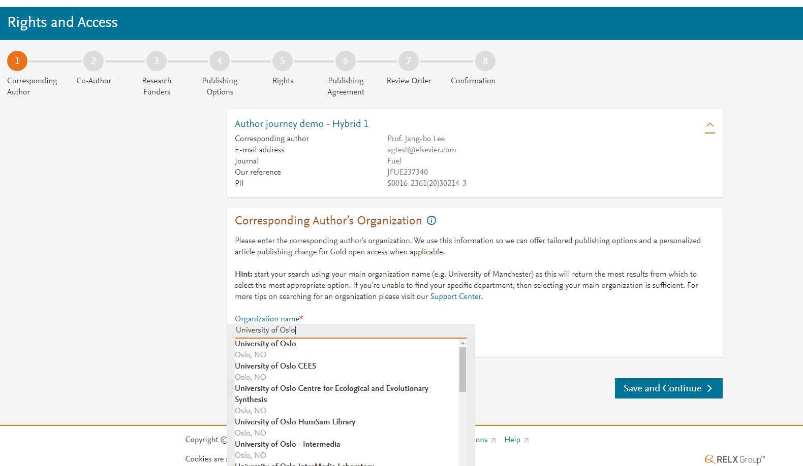
Corresponding author selects his/her affiliation details which we use to identify the authors and match them to the Norwegian agreement
Author selects University of Oslo in this case

Slide 4
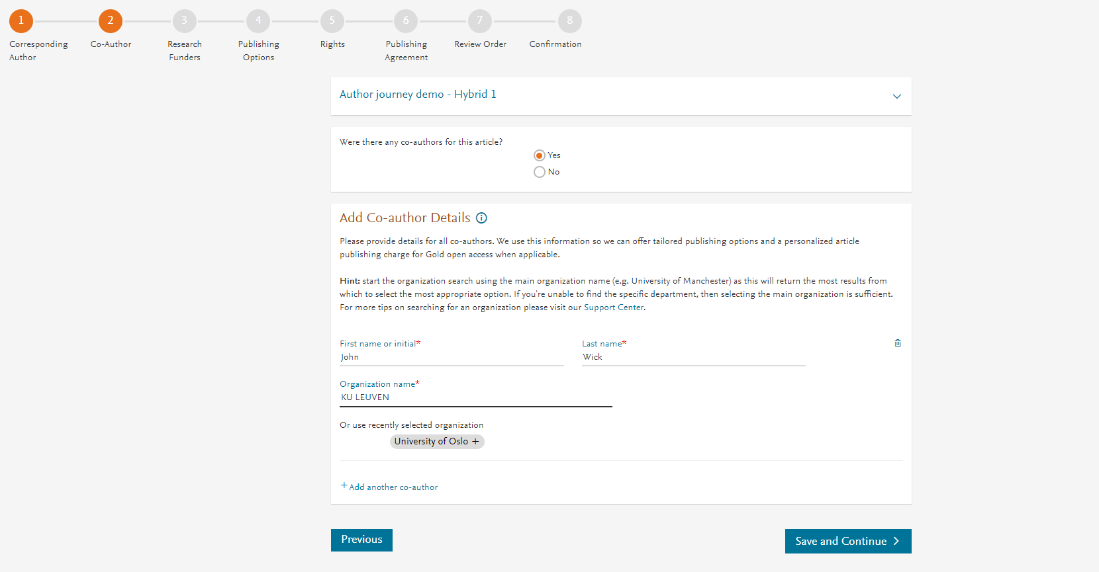
Corresponding author also adds the co-author affiliation details

Slide 5
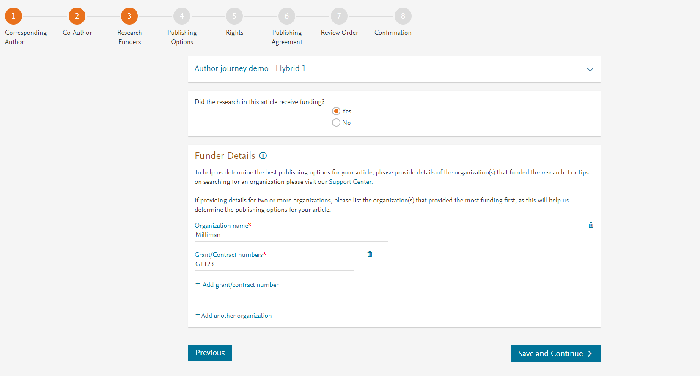
Author can add the Funder details. Funder can be the affiliated institute or a different one. In this case Milliman, United States is the Funder

Slide 6
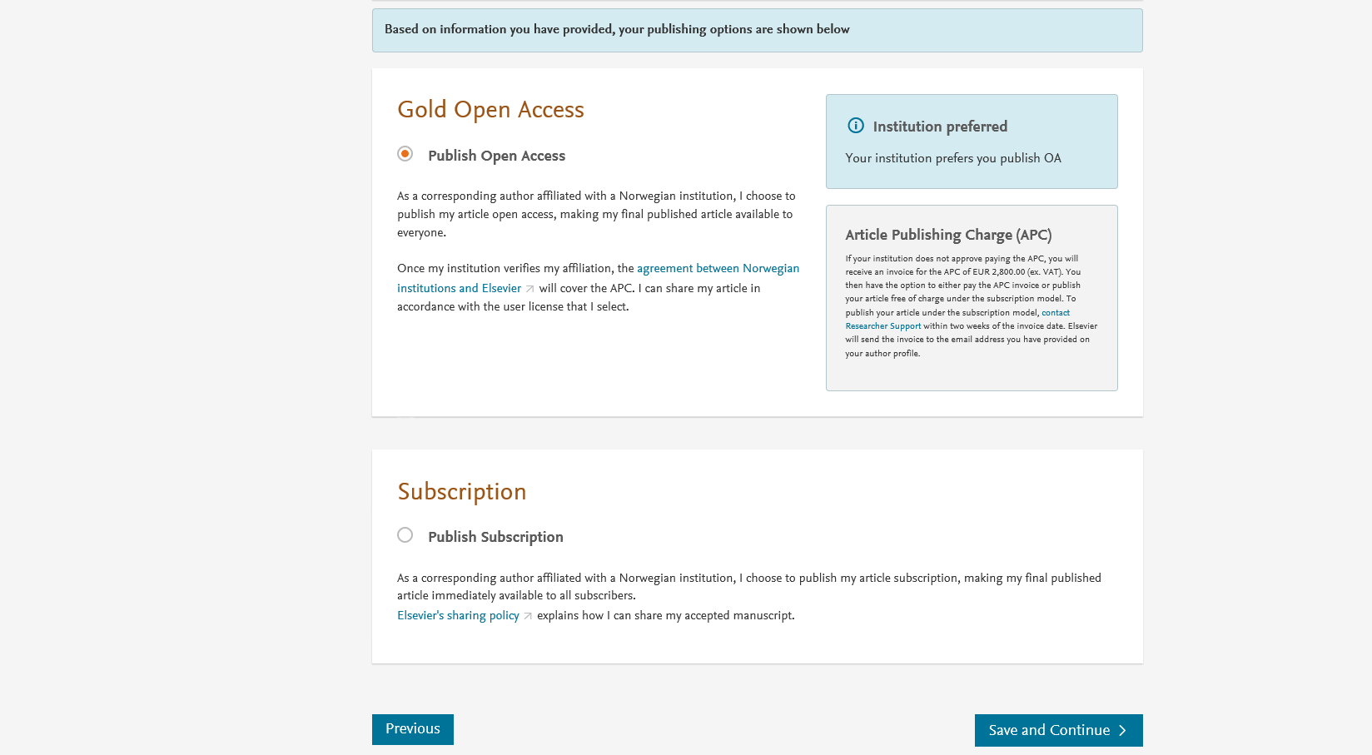
Based on the affiliation details, the author sees the Publishing Options. Gold OA option is followed by Subscription option and we make it clear that agreement covers full APC
If the librarian at the consortium rejects the author request in the Elsevier Platform, we also make it clear that the authors will receive a full price invoice
Author selects Gold OA in this instance but could also opt to publish under the subscription model
Gold OA option is pre-selected for the Norway agreement

Slide 7
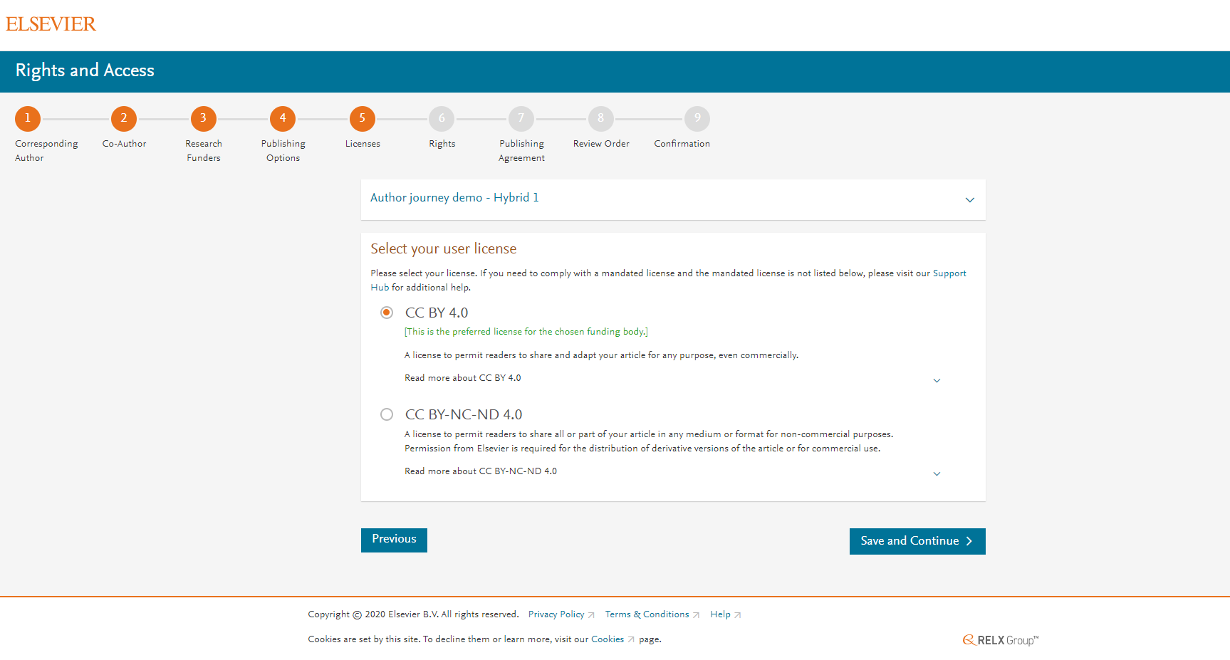
In case of OA, author selects the CC License
For Norway agreement, the CC BY license is preselected and we state UNIT’s preference

Slide 8
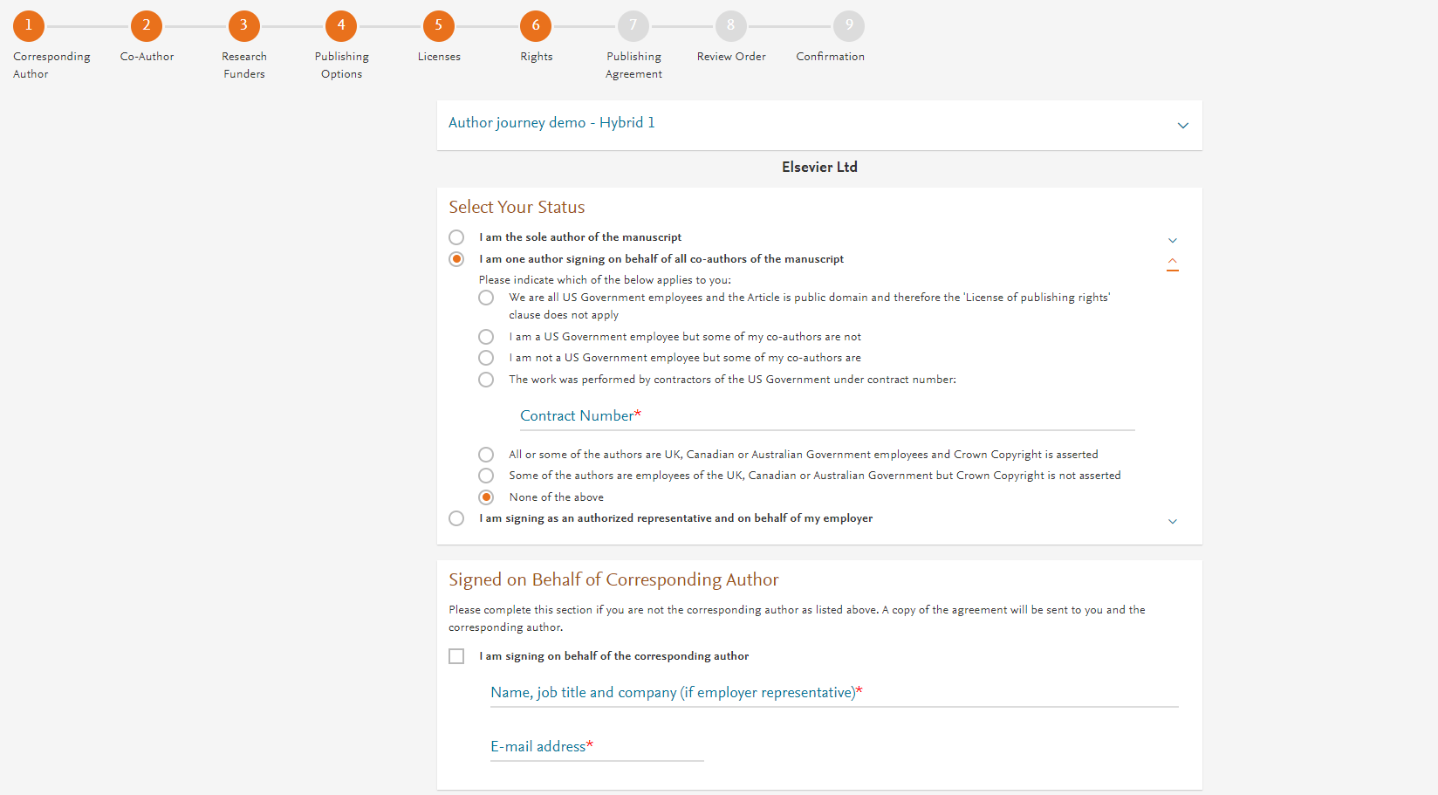
Author selects the rights

Slide 9
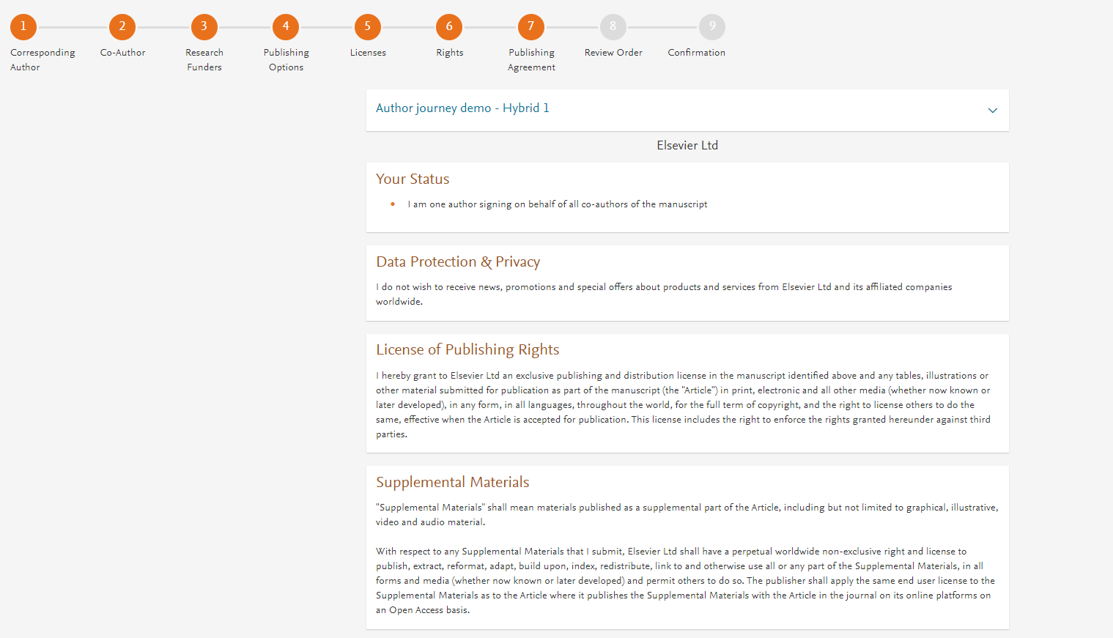
System presents author with the Journal License Publishing Agreement

Slide 10
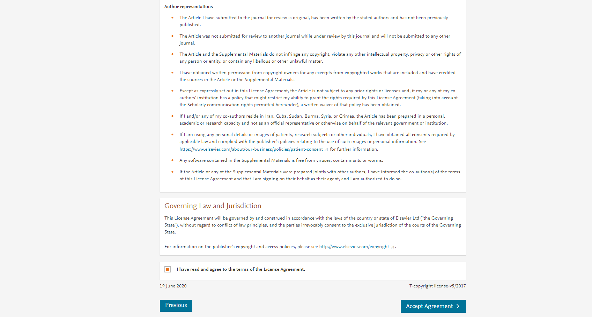
Author agrees to the Journal License Publishing Agreement

Slide 11
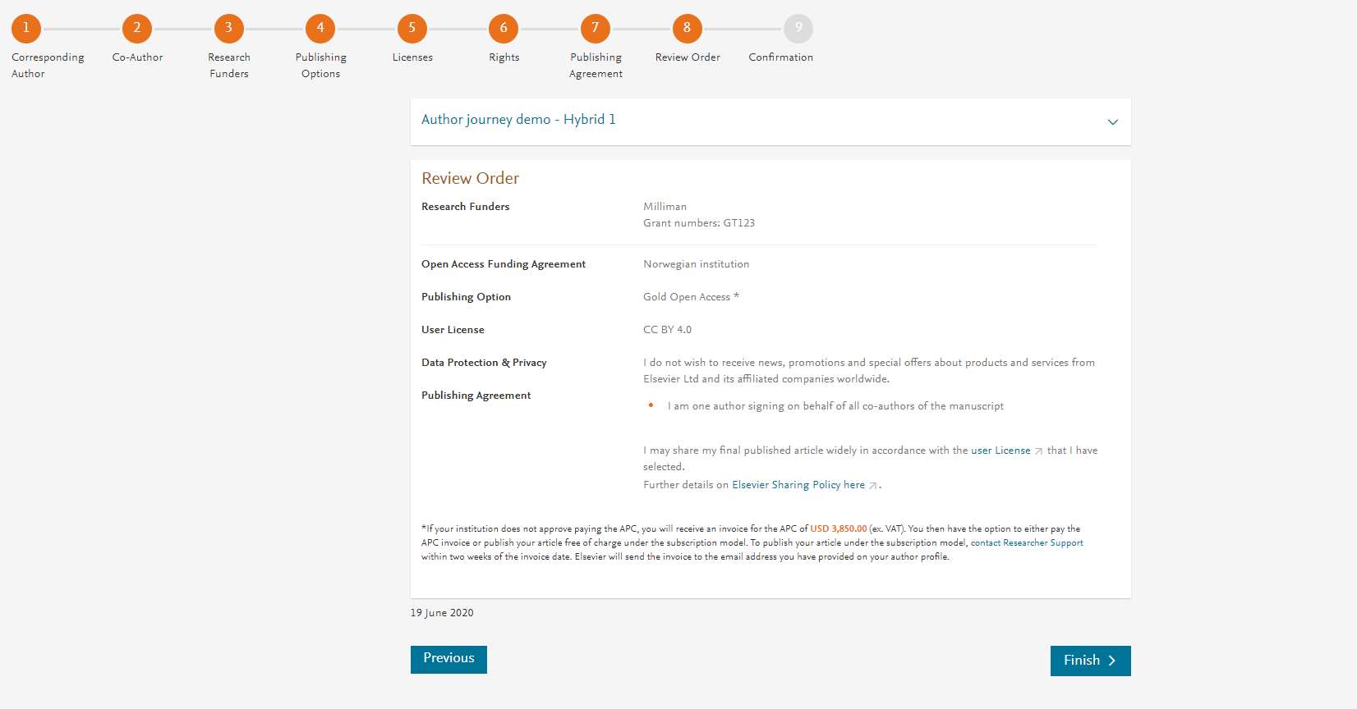
This is the summary page explaining the choices the author made in the publishing journey
Corresponding author and coauthors receive a copy of summary via email
The article becomes OA on ScienceDirect within 24 hours
The librarian at the institution will receive a request to validate the APC request within 48 hours

