Slide 1



Cover image
Please select the cover image you require from the following selection:
5 x Discovery stories (SN)
5 X Transformer images (SN)
Once you have chosen the cover image move the associated Thank you page to the end of the presentation and delete all the other cover and thank you pages.
Printing
When printing the deck you can reduce ink use by selecting:
Ctrl p (print)
Change the option to greyscale
SN Author Journey for Hybrid Journals
July, 2020
Antarctica meltdown could double sea level rise

Slide 2
Open Access – workflow overview
Section breaks
Section breaks are available in each palette colour and in a neutral blue grey.
In most cases one section break colour should be used consistently throughout the deck – ideally following the colour of the Advancing Discovery bookmark on the cover page.
1.0

Slide 3
OA publishing process
Editorial Acceptance
Identification
Corresponding author identifies him/herself as connected to a member institution
Verification
Identified article is sent to the member institution's article approval service accounts for final verification of eligibility
Publication
Submission
Manuscript is submitted
OA agreement specific eligibility check: in-scope journals, article types
Eligible article is published immediately open access
Submitting author provides e.g. FundRef and ORCID information, article category is assigned
OA Funding note added in article acknowledgments (if applicable)
Peer review is conducted in the following steps.
AAS account provides status reporting of identified articles
Account balance report /invoice

Slide 4
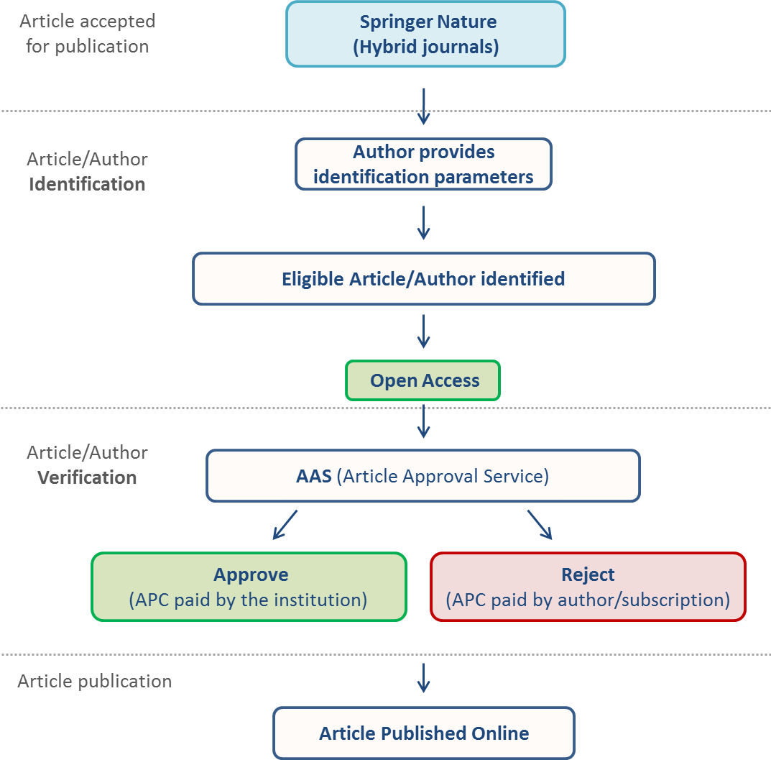
Workflow introduction – Author journey
Online processes that guide the author from article acceptance through publication for hybrid journals.
When completing the identification process, authors can identify themselves as eligible and be matched to an institutional agreement.
Once an author’s eligibility is confirmed by the institution, the article is published open access. In case of rejection, the author has the option to publish open access with their own funding or subscription.

Slide 5
Author journey – “MyPublication”
After article acceptance, the author receives an invitation to complete the publication process on “MyPublication.”
2.0

Slide 6
MyPublication – Overview
The majority of Springer Nature hybrid journals use MyPublication to identify the eligible authors and for the editorial rights processes.
Hybrid journals not using MyPublication are marked as “non-standard workflow” journals in the journal title list.
The corresponding author is guided through this workflow to manage all administrative tasks of the publishing process.
MyPublication stages:
Publish your article open access with an Open Choice option (if the journal is not a fully open access one)
Agree to terms of publication online
Order offprints or posters in addition to your free (electronic) offprint

Slide 7
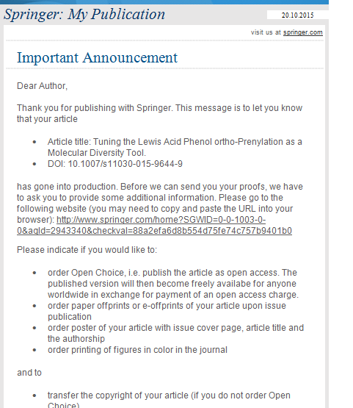
MyPublication – Article acceptance
    Once an article is accepted for publication, the author receives an email with a link to complete MyPublication forms.

Slide 8
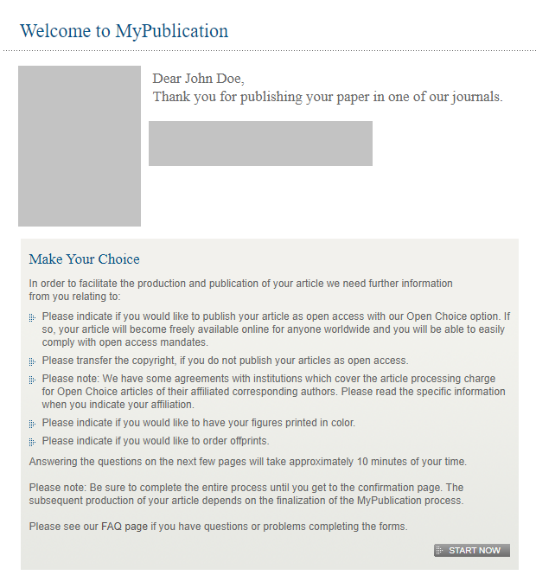
Welcome to MyPublication
Welcome page with overview of accepted article

Slide 9
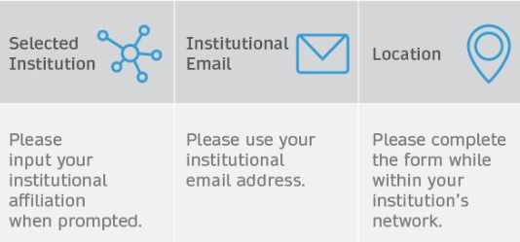
Author and article identification
After article acceptance, the corresponding author receives an invitation to complete the publication process for the article and the authors are able to identify themselves:
Corresponding author/article identification parameters:
    Selected institution
    E-Mail domain recognition
    IP recognition
    The hierarchy of identification parameters is in the above order: 1, 2, 3.
    Authors are informed about how they were identified.
    For example:
    Selected institution: University of Bergen
    E-Mail domain recognition: ETH Zürich
    IP recognition: FH Bern
    -> The author is identified under University of Bergen.

Slide 10
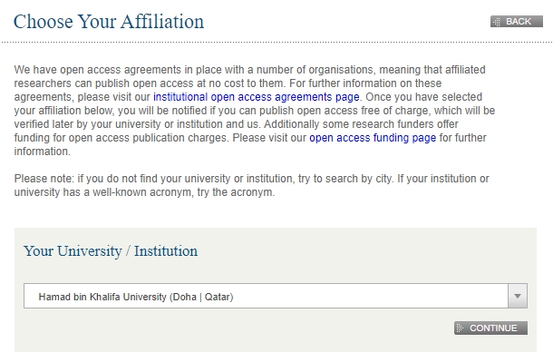
Choose Your Affiliation
    Authors can type in their institution in the search field. If authors can’t find their institution they can search by city

Slide 11
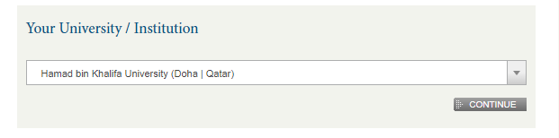
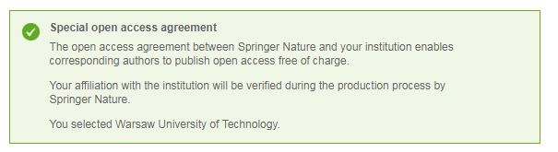
Choose Your Affiliation
    If the author is matched to an institutional agreement, a green box appears immediately, which provides further information on the OA agreement.
    Further identification parameters are IP address and email domain.

Slide 12
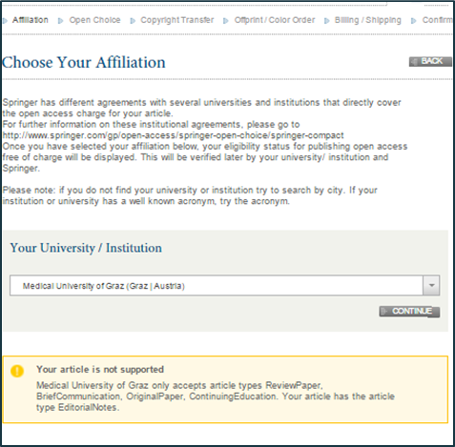
Choose Your Affiliation
    If the article type is not covered by an agreement, an orange box appears containing further information
Eligible article types covered by the agreement with Switzerland are:
OriginalPaper
ReviewPaper
BriefCommunication
ContinuingEducation

Slide 13
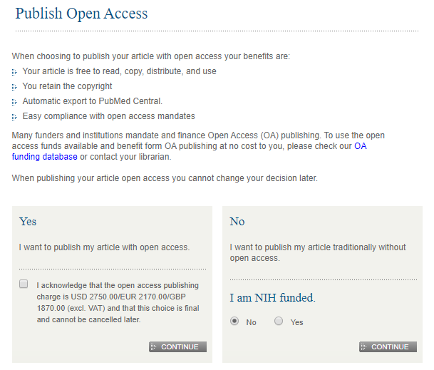
Your open access option
    If the article type is not covered, the author can choose to publish individually or traditionally non open access

Slide 14
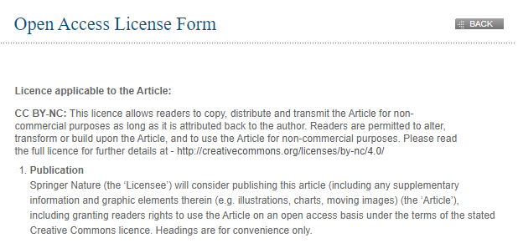
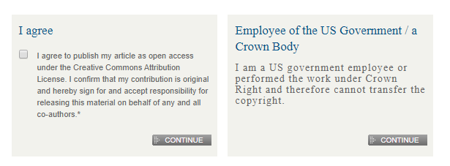
Open access license form
If the author opted for open access publication of the article, the author has to agree to the open access license

Slide 15
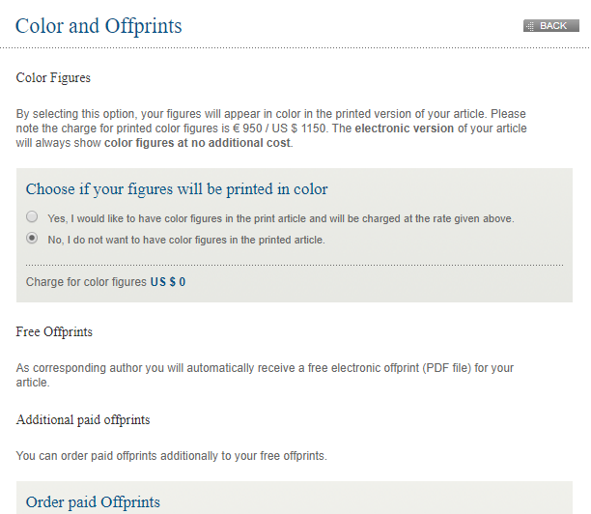
Colour and Offprints
    The author can order optional color figures as well as additional paid offprints and posters

Slide 16
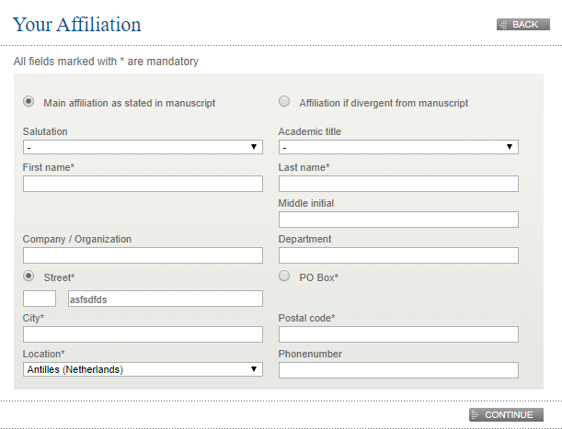
Your address
    The author states his or her invoice address even if there will be no invoice
    This is a generic page for all kinds of articles and is issued for data management

Slide 17
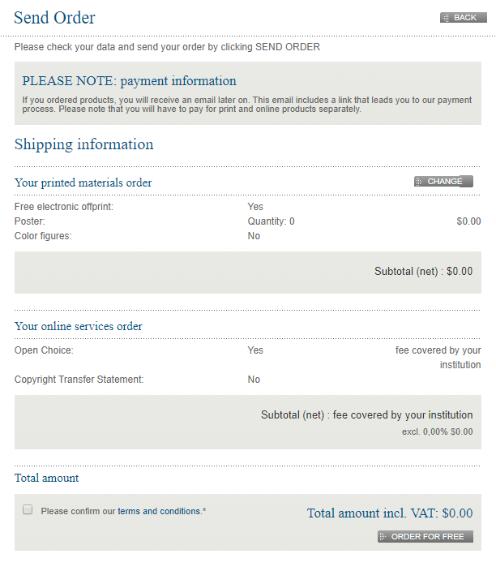
Send order
    On the last page there is a summary of all orders
    Open Choice is not charged to the author but is covered by the institution

Slide 18
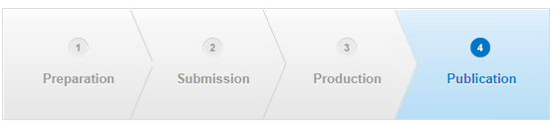
Support for authors
Contact details for further support are located on the MyPublication pages. Authors can also find helpful information in the FAQ, and in the author helpdesk

Slide 19
Useful Contacts
FOR AUTHORS and APPROVAL MANAGERS
OA verification (oa.verification@springernature.com)
FOR THE CONSORTIUM
OA verification (oa.verification@springernature.com)
OA Coordinator

Slide 20
Questions?
Thank you page
Make sure you have the thank you page associated with the cover image you have chosen and move this slide to the end of your presentation
Updating the footer
To update the footer:
Go the slide master via View
Scroll to the first page
Change text in the footer
Close slide master
oa.verification@springernature.com

