Slide 1
Publishing Open Access with ACS Publications

Slide 2
Need Information on ACS Open Science?
Visit ACS’ Open Science web site @
https://acsopenscience.org/
Notes:
our acsopenscience.org website has lots of good information on ACS Open Science and is also a place to find out who has institutional Open Access programs with us.

Slide 3
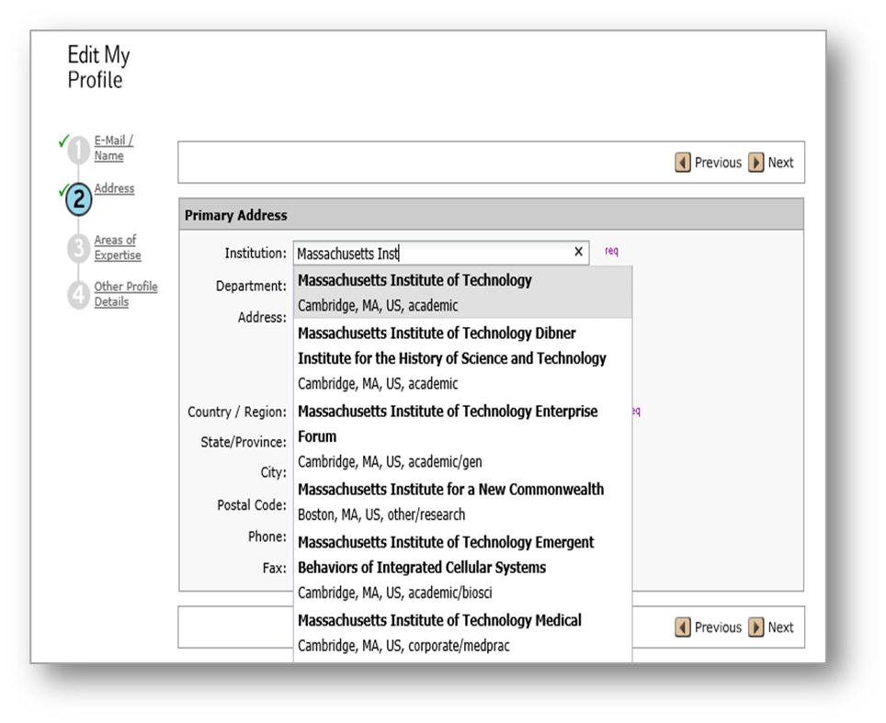
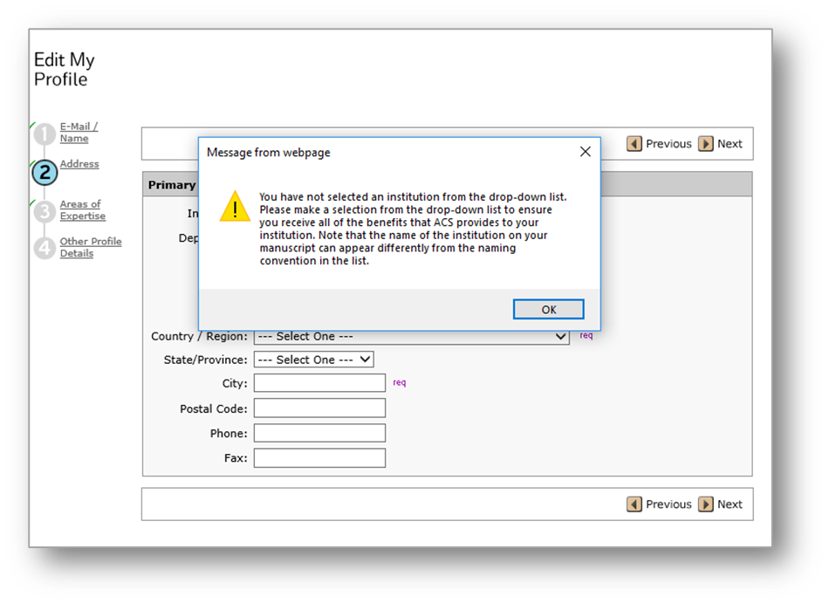
OA Agreement Affiliation Starts with Author Submission to ACS Paragon Plus
The corresponding author should select their institution in the Paragon Plus profile and list it in their manuscript
Notes:
Over the past few years, we worked on the data foundation of the programs which start with the authors affiliation at submission.
Once they select an institution from the dropdown box, this triggers the workflow at acceptance. If they decide to freeform their institution name, a warning box will appear, letting them know they could be missing out on institutional agreements and requesting them to use the dropdown selection.
When we started we had less than 20% articles with an affiliation attached. Now we have over 92%.

Slide 4
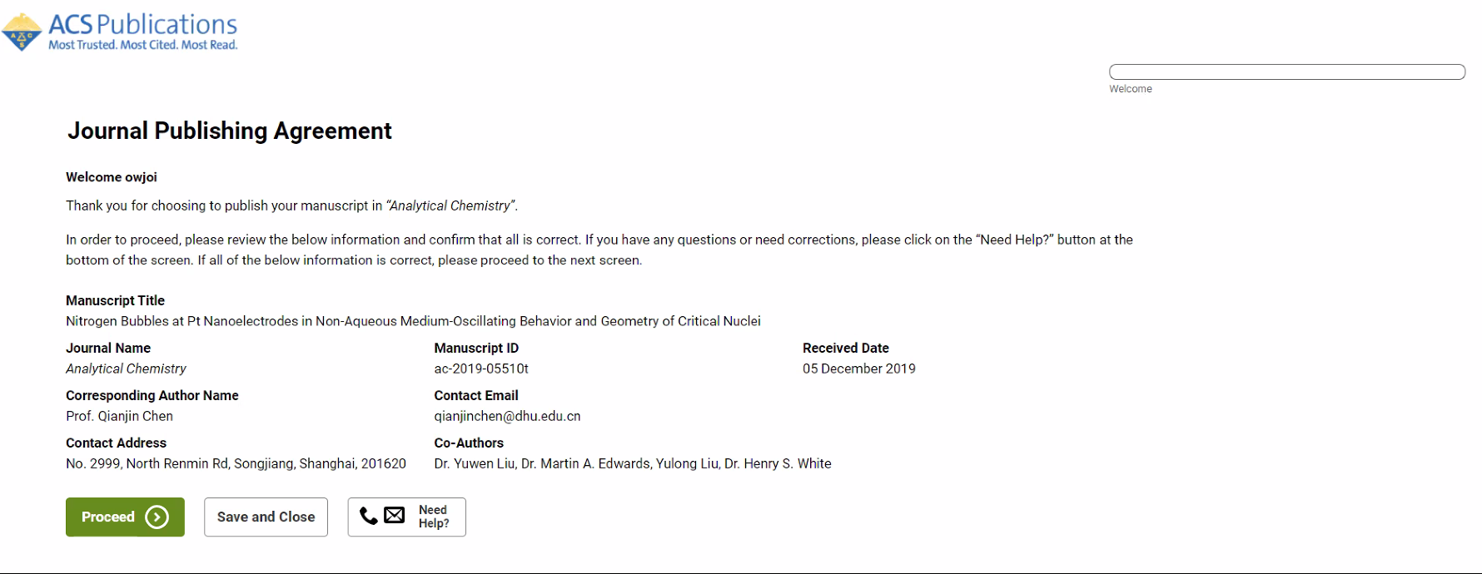
Manuscript Acceptance – Journal Publishing Agreement (JPA) Tool
Author is sent email invitation to enter the JPA Tool
Notes:
The JPA used to be signed at manuscript submission.

Slide 5
Manuscript Acceptance – Journal Publishing Agreement (JPA) Tool
The tool identifies if the author is affiliated with an Open Access agreement
If author chooses NO, they will go to the screen on next slide
Notes:
The tool lets the author know if the manuscript is affiliated with an institution that is part of an open access agreement and ensures they want to use that agreement to publish open access.
If choose NO, author will be taken to the screen in next slide.

Slide 6
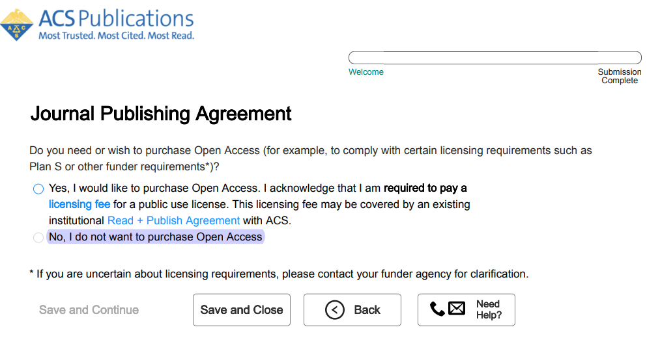
Manuscript Acceptance – Journal Publishing Agreement (JPA) Tool
Interactively drives author to appropriate JPA based on journal, agreement affiliation and author response
The author comes back to this screen if they choose NO on previous selection
For more information - Understanding copyright and the Journal Publishing Agreement
Notes:
At acceptance, the author will receive an email inviting them to sign a journal publishing agreement through the ACS JPA Tool. The tool uses data to automate part of the path as well as questions about the author’s desire to retain copyright to drive the author to the appropriate journal publishing agreement.
Author gets this one first if they are not associated with an agreement. If with an agreement only get this one if they say NO to slide 6.

Slide 7
Manuscript Acceptance – Journal Publishing Agreement (JPA) Tool
As author finishes the JPA3 Tool path, they are provided the link to complete Open Access transaction
If they are affiliated with a Touch-Free Agreement they do not get the link and are not required to complete any other actions to request funding.
Notes:
At the end of the JPA Tool process, when the author signed a JPA3 they will have the immediate opportunity to complete the open access funding request transaction. If they are part of a touch-free agreement the tool will thank them for completing the JPA process as the funding request has already gone to the agreement admin queue and there is no further action on the author’s part.

Slide 8
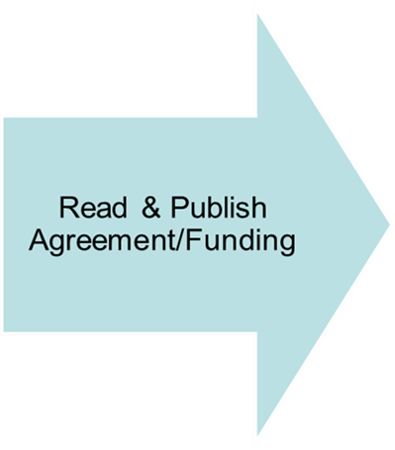
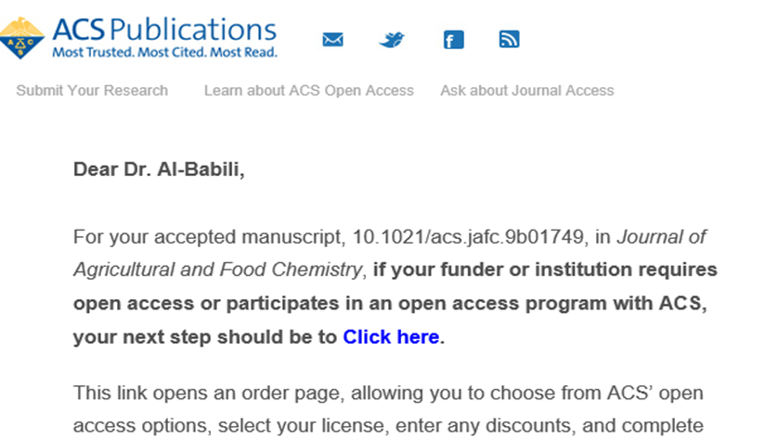
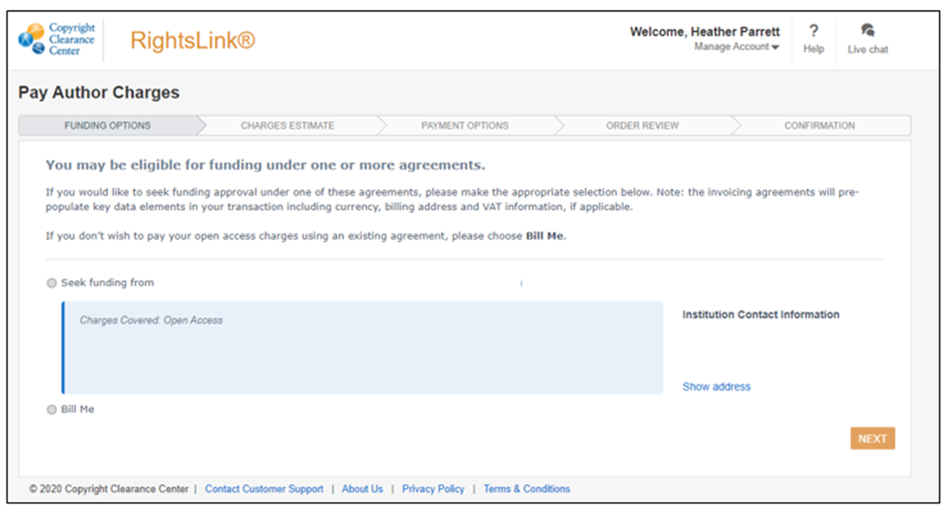
Author Completes Funding Request
This step is skipped if author is affiliated with an institution set up on a
Touch-Free Agreement
Notes:
Also at acceptance, the author receives and email like this to initiate the process. Once they click on the link in the email, they are taken to the CCC landing page where they can seek funding from their institution.
We also have options for our read and publish programs that bypass the author and go directly to allowing the admin to approve – becomes “touch-free” for the author. In some cases this is the preferred method to streamline the process but is completely optional.

Slide 9
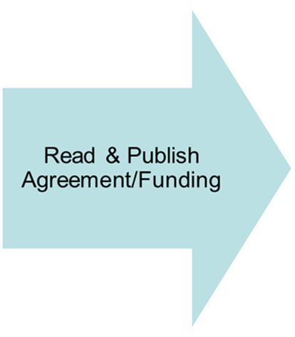
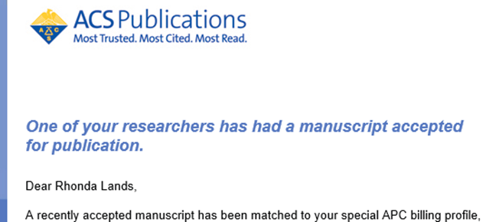
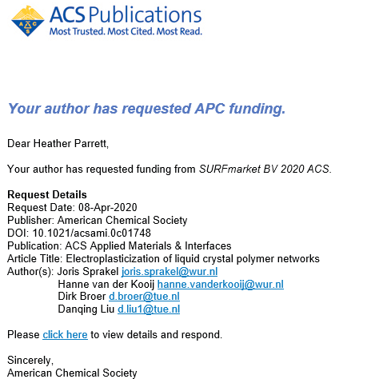
Agreement Administrator Notifications
Notes:
The agreement administrator is notified when they have an article accepted – this provides an opportunity to follow up as needed to ensure authors are taking advantage of the agreement.
Once the author has requested funding, the CCC agreement manager sends an email to the admin of the account that an author has requested funding for the article as well. – This is the only email notification received if the agreement is set up as touch-free.
The admin can use this email to click into their dashboard in CCC

Slide 10
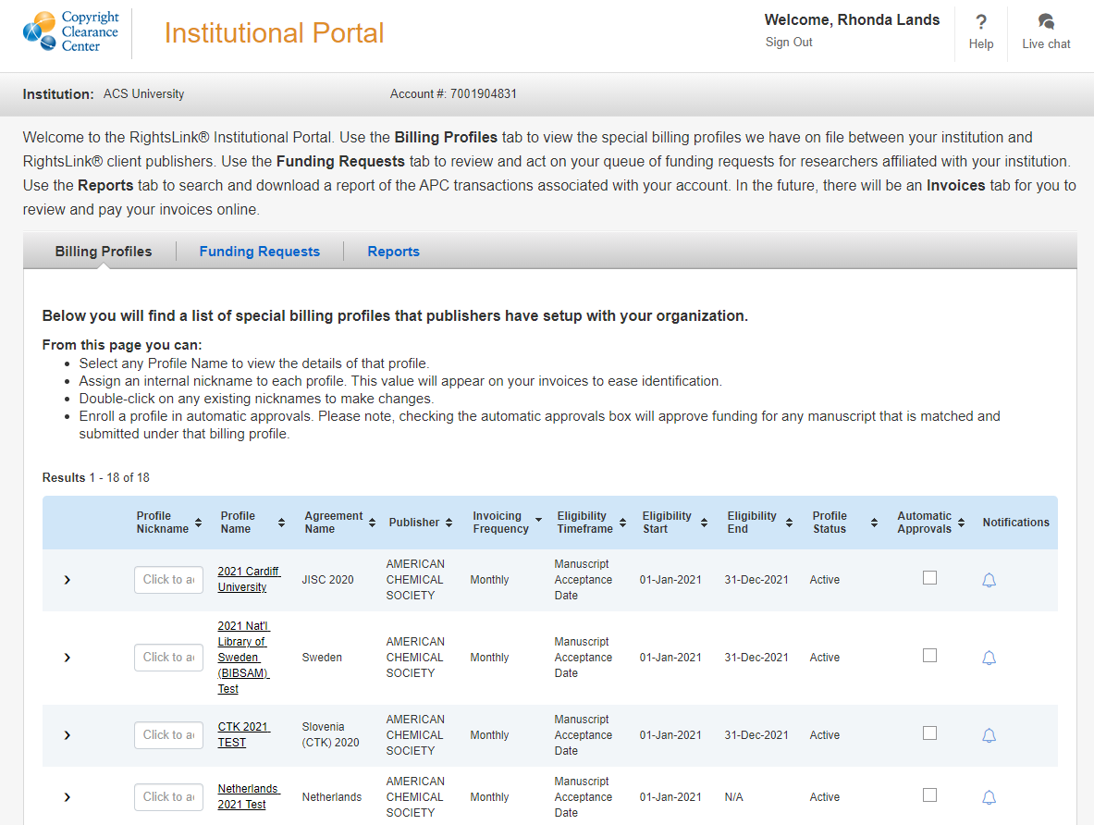
Billing Profiles-all Publishers in one place
Notes:
Billing Profiles provides you insight into all of your agreement profiles within CCC RightsLink. You can set notifications for yourself from this tab as well.

Slide 11
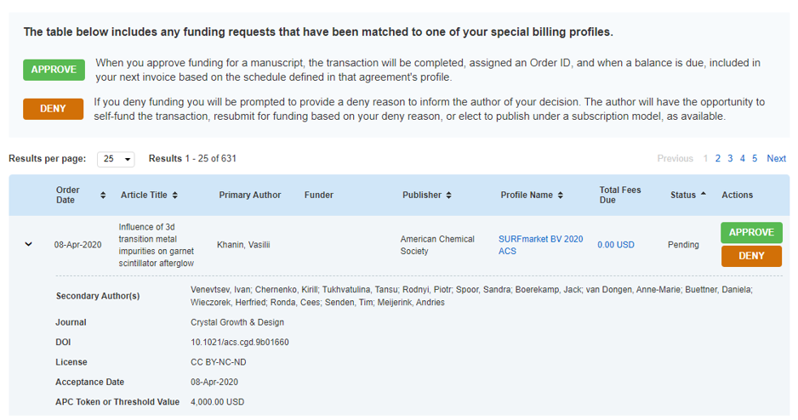
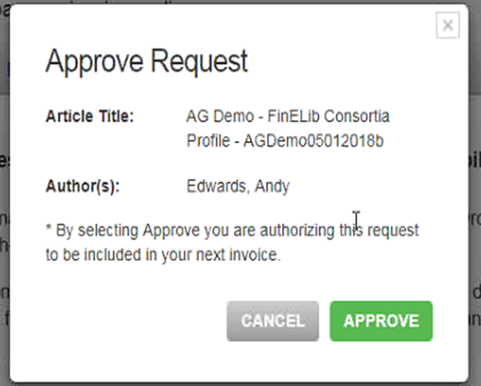
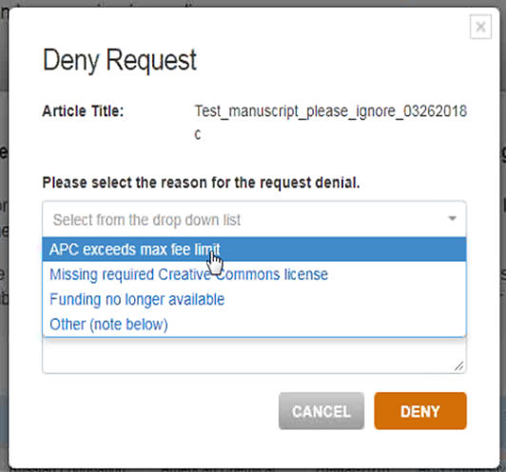
Funding Requests-all articles in one place
Notes:
At that point, the admin has the option to approve or deny the request, and has visibility to all articles in their dashboard.
If the institution has agreements with multiple publishers who use CCC, they would see all their articles here.
Once approved, the boxes are greyed out to allow easy visibility on necessary actions.

Slide 12
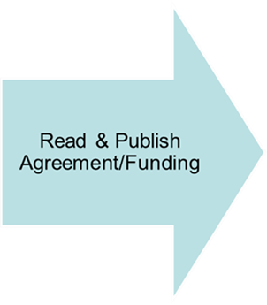
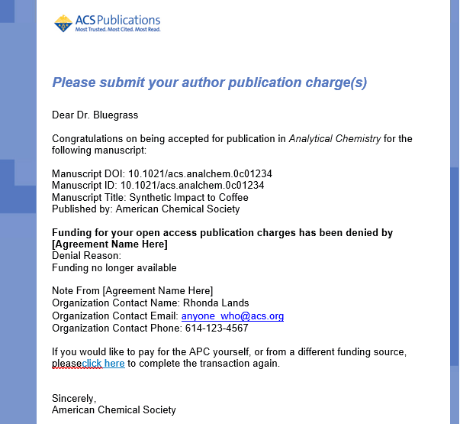
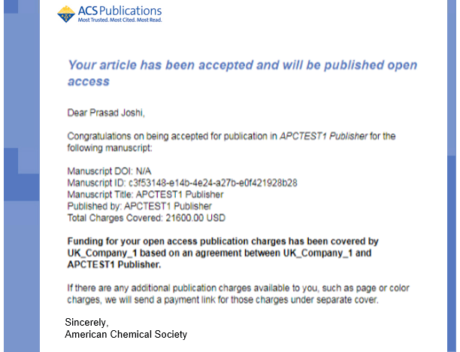
Author is notified of Approval/Denial
Notes:
Once an action is taken, the author is sent an email on the decision.
You can see here, if the request is denied, the denied reason is included.

Slide 13
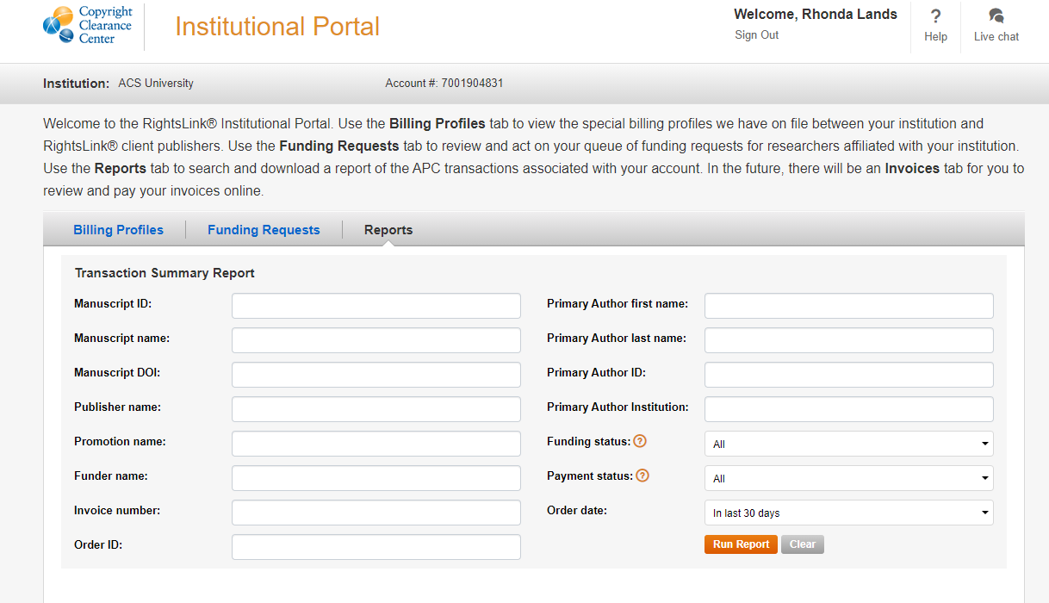
Agreement Administrator Reporting
Notes:
The CCC Institutional Portal provides reporting through the Transaction Summary Report.

Slide 14
Questions?

